Slide 1

The Road Map of HollandTown

Slide 2
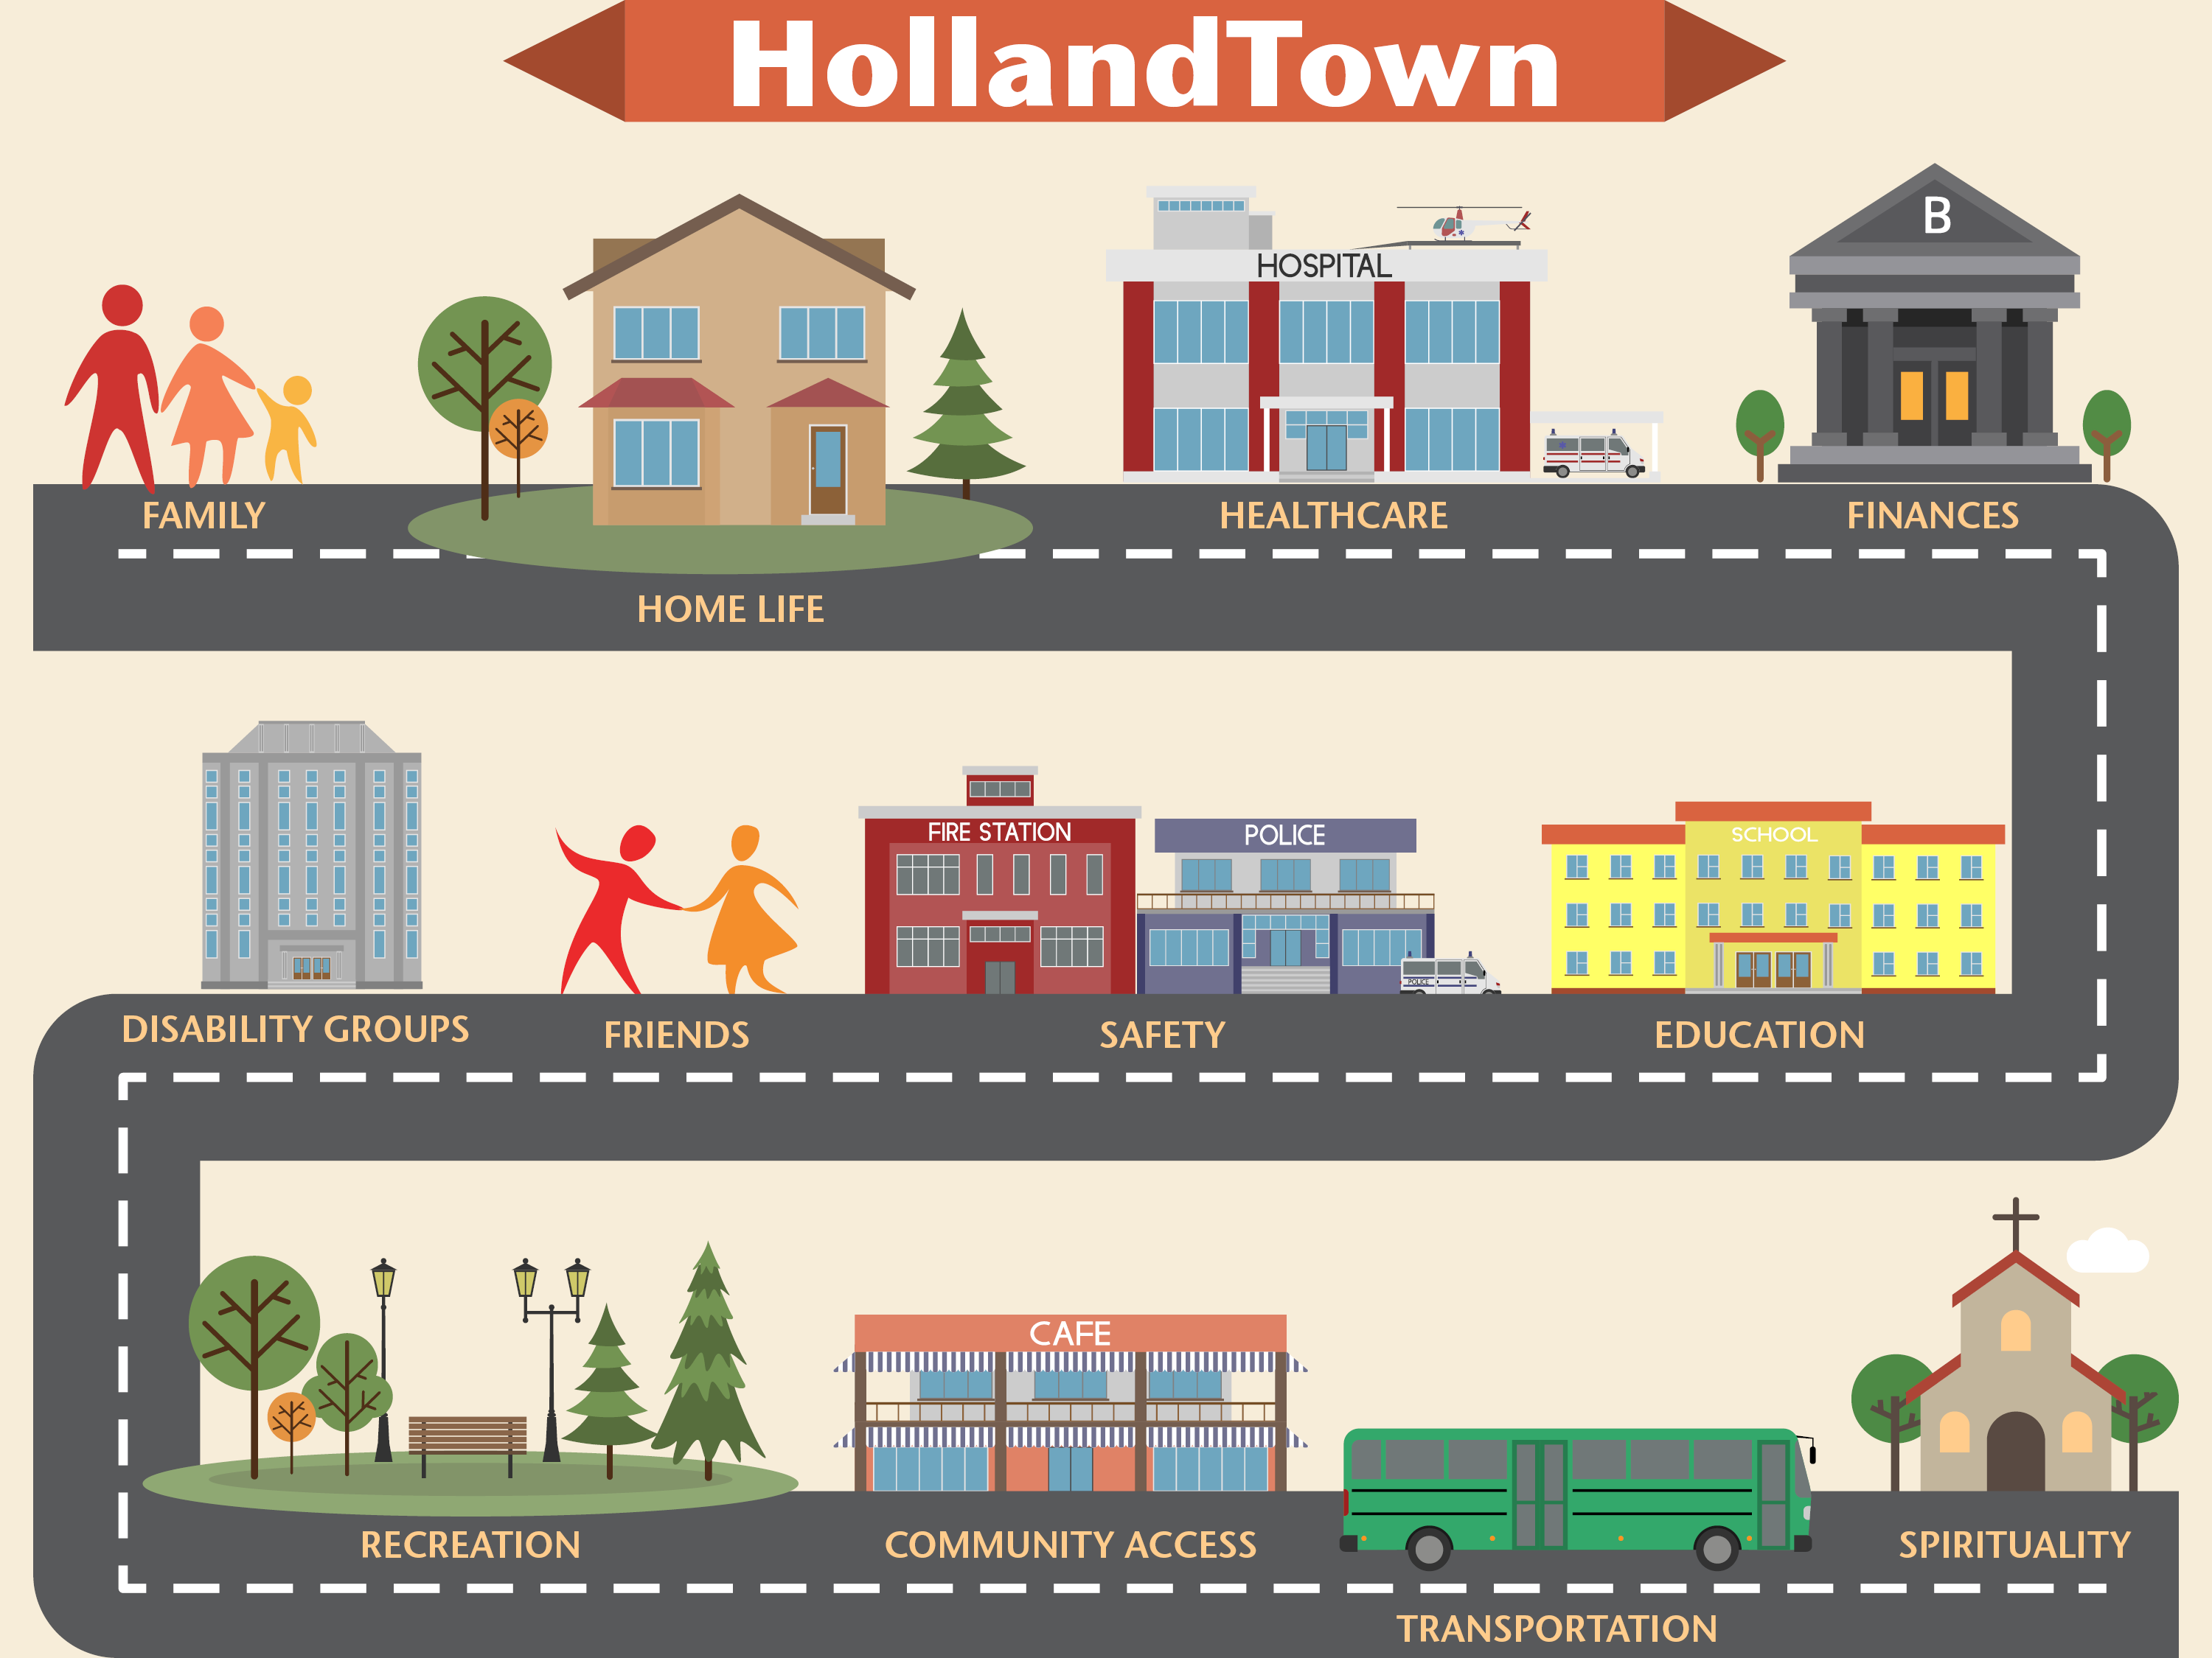

Slide 3
Remember the digital classroom at www.arcjc.org/login

Slide 4

Family

Slide 5
Disability & the Family:
Common Concerns
The relationship between parents is often more stressed
Many parents have trouble getting their extended family on board with the reality of a disability diagnosis
Parents struggle to find time to meet their child’s medical and therapeutic needs
Feeling like you have to do all the work and coordination on your own.
Worrying about how the typical siblings will be affected

Slide 6
Who can help me?
Parent support groups
Sibling support groups
Marriage and family counselors
Pastoral care
You

Slide 7
Let’s take a quick look at resources in the online classroom.

Slide 8

Home Life

Slide 9
Disability at Home:
Common Concerns
Physical adaptations and modifications to your home
Promoting safety in the home
Purchasing medical supplies
Dealing with behavioral issues
Addressing communication needs
Helping others understand your child
Respite and general child care

Slide 10
Who can help me?
Parent networks (in-person and online)
Health-Related Specialists
  Physical Therapists
  Occupational Therapists
  Speech Therapists
  Behavioral Therapists
  Primary provider/pediatrician
CCB Resource Coordinators
Google

Slide 11
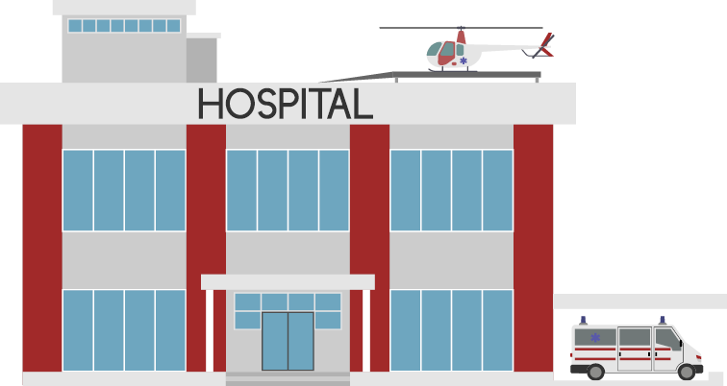
Healthcare

Slide 12
Healthcare:
Common Concerns
Managing your child’s healthcare needs
Paying for your child’s healthcare needs
  Is Medicaid an option?
  What are waivers?
Understanding your insurance coverage
What to do when you’ve been denied a service
Finding therapists and providers
Feeling overwhelmed for not knowing enough

Slide 13
Who can help me?
Doctors & Specialists
Physical Therapists
Occupational Therapists
Speech Therapists
Behavioral Therapists
Insurance Company Customer Service
Children’s Hospital Family Navigators

Slide 14

Finances & Legal

Slide 15
Financial & Legal:
Common Concerns
Paying for your child’s unique needs
Planning for your child’s needs if something happens to you
Special needs planning
Applying for SSI/SSDI
What’s the ABLE Act?

Slide 16
Who can help me?
Estate Lawyer – Creates legal plans
Financial Advisor – Advises on how to fund plans
Parent networks (in-person and online)
Internet
Government program administrators

Slide 17
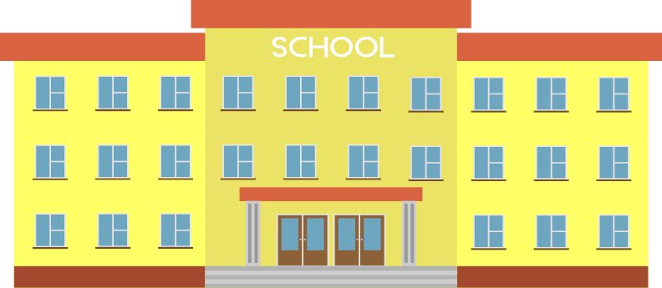
Education

Slide 18
Education:
Common Concerns
Too many to list!
Understanding your student’s rights
What’s all the fuss about inclusion?
Knowing how the process works
What to do when the process breaks down
The school’s role in delivering therapeutic services

Slide 19
Who can help me?
Advocates
  The Arc’s advocates
  Paid special education advocates
  Special education lawyers
Parent training organizations mandated by law (ex. PEAK Parent Center)
Parent networks (in-person and online)
Your child’s school team
You

Slide 20
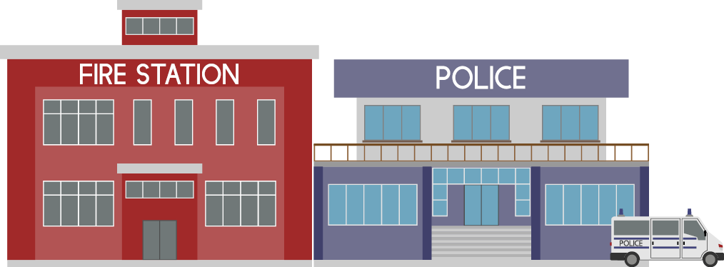
Safety

Slide 21
Safety:
Common Concerns
Maintaining my child’s safety in different environments
My kid is a runner
What if my child gets lost
My child injures themselves or others

Slide 22
Who can help me?
Community safety (Police & Fire)
Behavior therapist
Your medical team
Parent networks (in-person and online)
You

Slide 23

Friendships

Slide 24
Friendship:
Common Concerns
Helping your child find friends
Strategically building friendships
Building friendships through recreation
Building a parent network for yourself
How do typical kids make friends?

Slide 25
Who can help me?
Coaches and activity leaders
Parent networks (in-person and online)
Support groups
Sibling Clubs
You

Slide 26
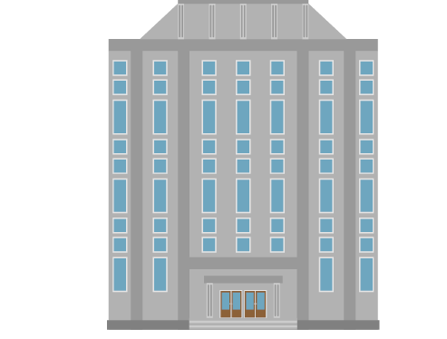
Disability Groups

Slide 27
Disability Groups:
Common Concerns
Sorting out who does what
Understanding Community Centered Boards (CCBs)
Categorizing disability groups
Sorting out the acronyms
What does The Arc do?

Slide 28
Categorizing disability groups
Government entities:
  Ex. Social Security, Medicaid, Health & Human Services
  Can be federal, state or local level
Quasi-Governmental entities
  Ex. Community Centered Boards
  Services funded by a blend of public and private dollars
Community-based non-profit organizations:
  Ex. The Arc, Sibling Tree, RMDSA, Autism Speaks
  Largely privately funded with a specific scope of work

Slide 29
Understanding CCB
Authority & Funding
Community Centered Boards are quasi-governmental organizations in the state of Colorado, whose current role is to coordinate and deliver government services for people with I/DD
CCBs, per state statute, determine disability using a stricter definition than the federal government.
Services funded by Medicaid dollars administered by the Colorado Department of Health Care Policy and Finance
Additional funding comes from local mil levy dollars

Slide 30
Colorado Definitions of Developmental Delay and Disability
Visit DDRC online and click “Show Definition” to see more.
http://ccb.ddrcco.com/developmental-disability-resources/developmental-disabilities-services.php

Slide 31
What Services do CCBs Provide?
Case Management
Service Coordination
Waiver Administration
Service Provision
  Cash subsidy (Family Support)
  Behavior Team
  Depending on waiver, can include:
    Respite care
    Therapies
    Home healthcare
    Other services for adults

Slide 32
Who can help me?
The Arc
Resource Coordinators
Community groups
Parent networks (in-person and online)
Google

Slide 33
Favorite Resources:
Disability Groups
The list is too long! Please visit the online classroom to learn more.

Slide 34
BREAK?

Slide 35

Recreation

Slide 36
Recreation:
Common Concerns
Inclusive recreation experiences
Therapeutic recreation services
Summer and day camps
Supporting your child in typical recreation environments
Paying for recreation

Slide 37
Who can help me?
You and the coach or leader in charge
Parent networks (in-person and online)

Slide 38

Community Access

Slide 39
Community Access:
Common Concerns
The places you want to go aren’t physically accessible
Food issues – special diets, difficulty eating, alternative feeding methods
Going to the bathroom – will their be an accessible bathroom? Will you be able to change diapers or catheters?
It feels like people are staring at or judging you
You’re not sure how to explain to strangers, or if you should
Fear of being asked insensitive questions, or of how you’ll respond
Overcoming obstacles to community

Slide 40
Sharing with Strangers
The brief statement: “He has autism”
A slightly longer story introducing your child and any things strangers need to be aware of: “he doesn’t talk, he doesn’t like hugs, he loves trains”
The whole shebang, for when you meet someone who is familiar with situations like yours and it all spills out.
Homework: Take time to draft your 2-3 minute stranger introduction. You will be sharing this with the group the last night of training.

Slide 41

Transportation

Slide 42
Transportation:
Common Concerns
Accessible vehicles
Parking placards
Air travel concerns
Are you the only one that can lift a wheelchair?

Slide 43
Who can help me?
The internet
Parent networks (in-person and online)
You

Slide 44

Spirituality

Slide 45
Spirituality:
Common Concerns
Childcare for my child during service
Disruptive behaviors or vocalizations
Finding welcoming churches
Knowing when to move on

Slide 46
Who can help me?
You
Faith community leadership

Slide 47
Tips for finding a spiritual community
Google: “Special needs [church/synagogue/ministry] Denver”
Talk to your community’s leaders
Talk to other parents
Be willing to help other’s learn

Slide 48
Your Roadside Advocacy Kit

Slide 49
Critical Skills & Tools
  Communicating effectively
  Conflict Resolution
  Assertiveness
  Researching
  Organizing
  Resourcefulness
  Resiliency

Slide 50
Closing
  Table Talk
    What are your top concerns today?
    Where do you need to get started?
    Who can help you ?
    What can wait until later?

Slide 51
Homework:
  Work on your 2-3 minute family introduction
  Check out online classroom!

