Slide 1










Social Security Administration
Disability Benefits at Age 18
Person-centered Independence Planning Project (PIPP) - funded through the Colorado Workforce Development Council and the Colorado Department of Labor and Employment
Notes:
Greetings! Thank you for choosing to attend this session entitled “Social Security Administration Disability Benefits at Age 18”. My name is Peter Pike and I work for Colorado WIN Partners/University of Colorado Denver. This training session is brought to you by the Person-Centered Independence Planning Project which is funded by the Colorado Department of Labor and Employment and the Colorado Workforce Development Council. This initiative is a strong coalition of partners including the Jefferson County Workforce Center, the Tri County Youth Council, Jeffco Public Schools, The Arc in Jefferson County, Division of Vocational Rehabilitation, Developmental Disabilities Resource Center, Jefferson Center for Mental Health, Child, Youth and Families of Jefferson County, Social Security Administration, and Colorado WIN Partners.
1

Slide 2
Youth with Disability
Social Security Administration
&
Disability Determination Services
Notes:
Hello everyone, my name is Ida Whitelow from SSA and also with me is Mike Baska from SSA and Ira Salladay of our Disability Determination Services. We’re going to talk to you about the SSA Disability Program. SSA administers two different programs: Supplemental Security Income and Regular Social Security Benefits.

Slide 3
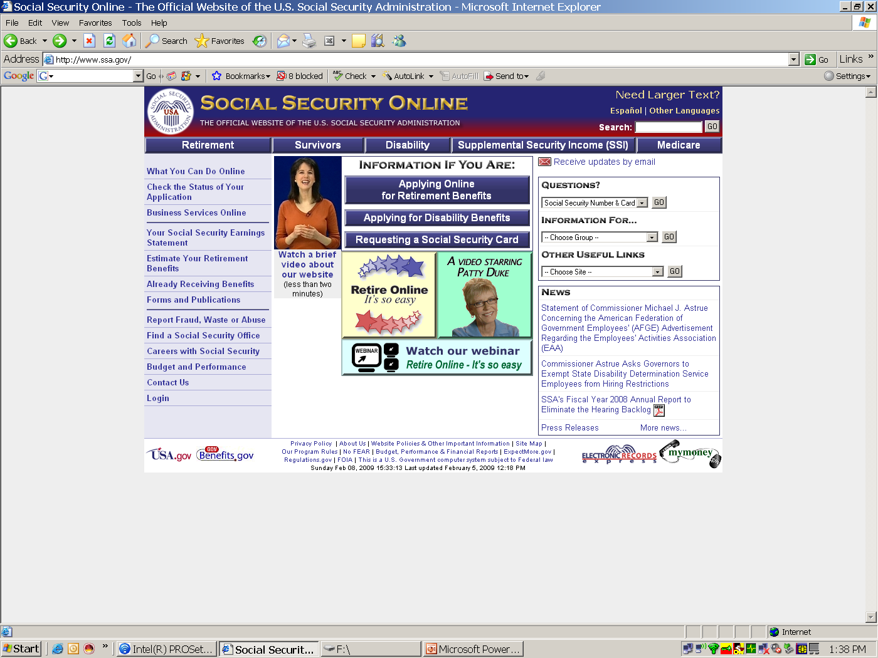
www.socialsecurity.gov
Notes:
You can get more information on these programs at the SSA website, www.socialsecurity.gov.

Slide 4
www.socialsecurity.gov
Notes:
The tab labeled disability will give you some more information.

Slide 5
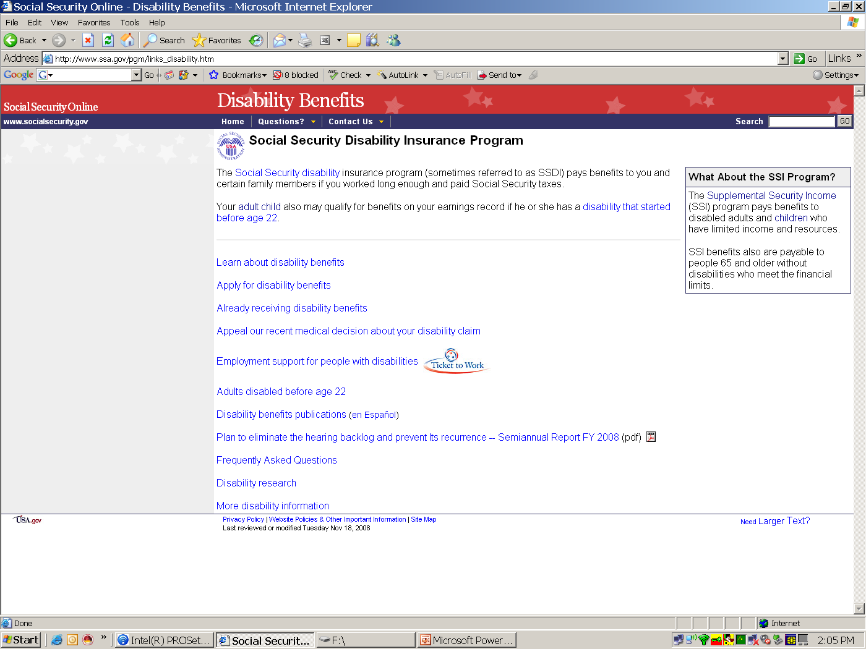
Notes:
Social Security Disability Insurance pays benefits to someone who has worked before and paid into FICA taxes and then become disabled. On the other hand, the Supplemental Security Income program is based on limited income and resources.

Slide 6
Notes:
I’ve highlighted a couple of aspects of these programs, by these stars here, including some frequently asked questions, so let’s take a look at that.

Slide 7
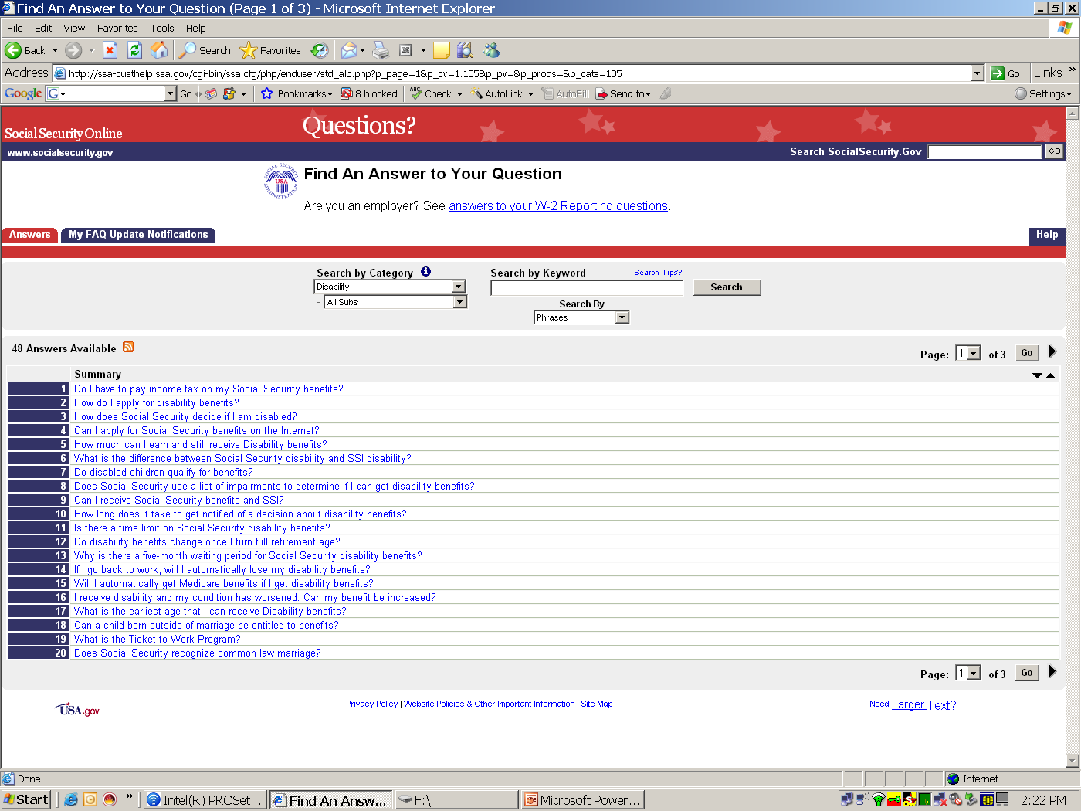
QUESTIONS?
Notes:
Let’s look at number 6: What is the difference between SSI and SSDI?

Slide 8
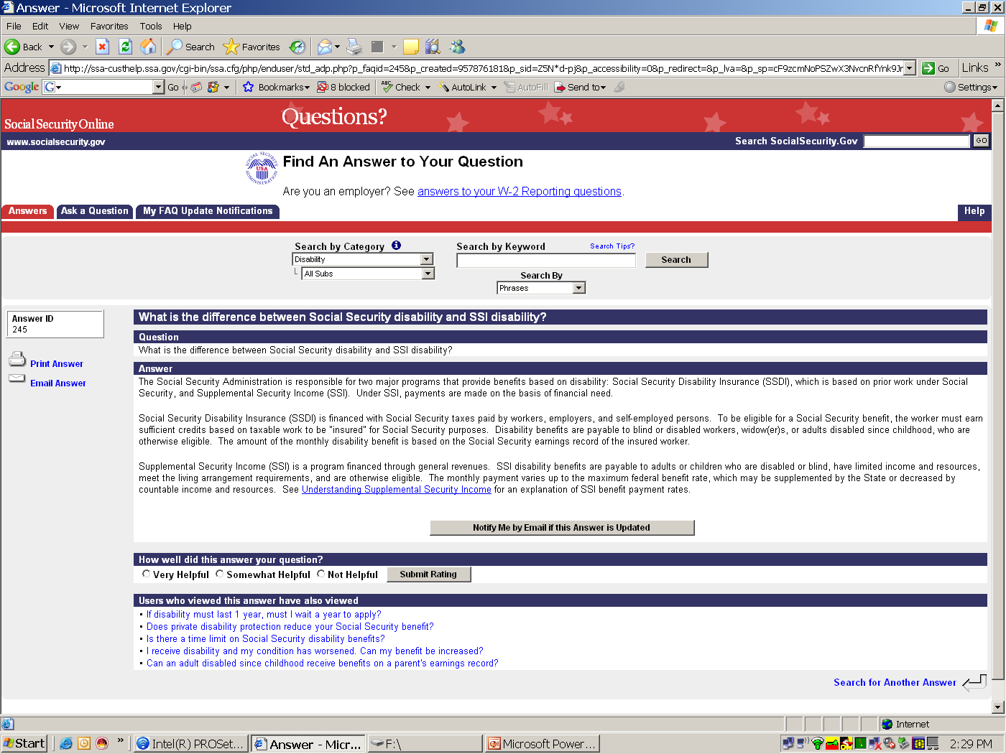
ANSWERS
Notes:
SSDI looks at your disability and if you’ve paid into FICA taxes in the past while working. Then you get coverage based on quarters worked. In 2009, one quarter was worth $1090.
SSI doesn’t look at if you’ve worked, it’s financially needs based. We look at income and resources.

Slide 9
ANSWERS
Notes:
A good way to stay on top of these topics is to have information emailed to you. It’s a good way to stay informed.

Slide 10
Supplemental Security Income (S.S.I.)
Definition of Disability
A physical or mental impairment (or combination) that has lasted or can be expected to last for at least one year or result in death and
Child – under Age 18
Causes marked and severe functional limitations
Adult – over age 18
Prevents you from working
Notes:
I want to talk a little more about the SSI piece. SSI looks at a common element for children and adults. In order to qualify, a person must have physical or mental impairment, or combination of the two. The impairment must have lasted for a year or more or it will result in death. SSA considers someone a child if they are under age 18 and have marked and severe functional limitations. Once someone is 18 or over the age of 18, SSA looks at whether or not the disability prevents a person from working. SSA is pretty strict about the definition of disability.

Slide 11
S.S.I.
Supplemental Security Income
SSA also looks at non-medical criteria when determining eligibility for SSI. This is true for both children & adults.
  We look your living arrangements.
  for example…
  Do you live alone or with others?
  Do you rent or share expenses?
  Do you receive free room and board?
Notes:
SSI is financial based; we look at 3 criteria to evaluate. Living arrangements, how the person is living.

Slide 12
S.S.I.
Supplemental Security Income
SSA also considers money and assistance received, as well as assets available for support and maintenance.
This is true for both children & adults.
- We look your income and resources.
for example…
Notes:
Income and resources are the other two components.

Slide 13
S.S.I.
Limited Income & Resources
UNEARNED INCOME is money and help you receive other than earnings from work. You cannot exceed $694/month for an individual
RESOURCES are things you own. SSI does not count everything you own. You cannot exceed $2000 for an individual
Notes:
For instance, we look at unearned income which is money and help you received but did not work for. In 2009, unearned income cannot exceed $694 monthly. The other thing we look at it resources and these are things that you own. In 2009, resources cannot exceed $2000 monthly.

Slide 14
S.S.I.
Income also includes…
Other help received - such as free or reduced rent or food – may be considered. This is true for all individuals eligible for S.S.I.
The full S.S.I. benefit of $674/month in 2009 is reduced by about $225/month unless the actual value of the help is less.
Notes:
Another type of income is help you get for someone who helps you pay for rent, food, etc… This is called in kind income or support and SSI is going to look at that. For the full benefit amount of $674, it can be reduced for up to $225 to make up for that in kind income or support you receive by living with someone and not paying for rent or paying for any food.

Slide 15
S.S.I.
Resources
SSI considers things you own but does not count everything.
Examples of countable resources are:
cash, bank accounts, extra vehicles, and non-home property.
Examples of non-countable resources are:
one car and your residence.
http://www.ssa.gov/ssi/links-to-spotlights.htm is an excellent source of easy-to-understand SSI topics.
Notes:
Also, when we talk about resources SSI looks at what you own. We don’t look at everything though. We’re only going to count one of your cars if you own two. And we won’t count a house that you own if it’s the home that you live in. But we do look at extra property, cash you have in bank, and other resources like mutual funds. The month that you receive income, we don’t count it as resources. But if you keep that income into the next month, then it’s counted as a resource.

Slide 16
S.S.I.
Income
Until age 18, some parental income and resources are considered available for the child’s support.
Deeming of income & resources to the child from parents within the household ends at adulthood.
Notes:
Now, until someone reaches age 18, some of the parental income and resources are considered available for child. This is called deeming. Deeming ceases at 18 though and then we look at them as an adult. And this brings me to the next topic, Age 18 redetermination.

Slide 17
S.S.I.
Age 18 Redetermination
When SSI beneficiary turns age 18 SSA performs a re-determination of eligibility.
In order to continue to receive benefits must meet Adult disability rules.
We then consider the ‘child’ as an adult, and look at only at his or her income, resources and living arrangement.
We no longer DEEM parental income & resources affective the month after age 18.
Notes:
Now we’re going to look at medical and nonmedical criteria for the person as an adult. This can be a good thing because we’re no longer looking at the parents’ income or resources, we’re looking at the individual. So if a child wasn’t able to get SSI because a parent made too much or had too many resources, the child may be able to qualify when they turn 18 because we look at their individual resources and income.

Slide 18
S.S.I.
Supplemental Security Income
Adult – over age 18 – SSA’s Definition of Disability
A physical or mental impairment (or combination) that -
  Prevents you from working and
  Has lasted or can be expected to last for at least one year or result in death.
  There is no partial or temporary disability benefit
  under Social Security.
Notes:
I’m going to reiterate what we mean by adult. An adult is someone who is 18 or older who has a physical or mental impairment that prevents them from working and has lasted, or is expected to last, a year or more or will result in death. Now I’m going to turn it over to Mike.

Slide 19
www.socialsecurity.gov
Notes:
As Ida mentioned, on SSI there’s limits to money received or assets held. The maximum amount and adult can make in a month and still qualify is $694. Once you surpass that, you don’t qualify. This includes pension, annuities, and money you acquire (like if you win the lottery or something). Resources are things you own or retain like property. But as Ida said the home you live in doesn’t count against as a resource and neither does one car if you own more than one. The value of resources cannot exceed $2000. If the things you own exceed $2000, then you don’t qualify. So it’s important to keep those limits in mind.

Slide 20
www.socialsecurity.gov
Notes:
Now we’re going to talk about applying for SSI from our website, www.socialsecurity.gov. This is a good website to be at, there’s a lot of good info. We’re going to narrow the discussion down to applying for benefits.

Slide 21
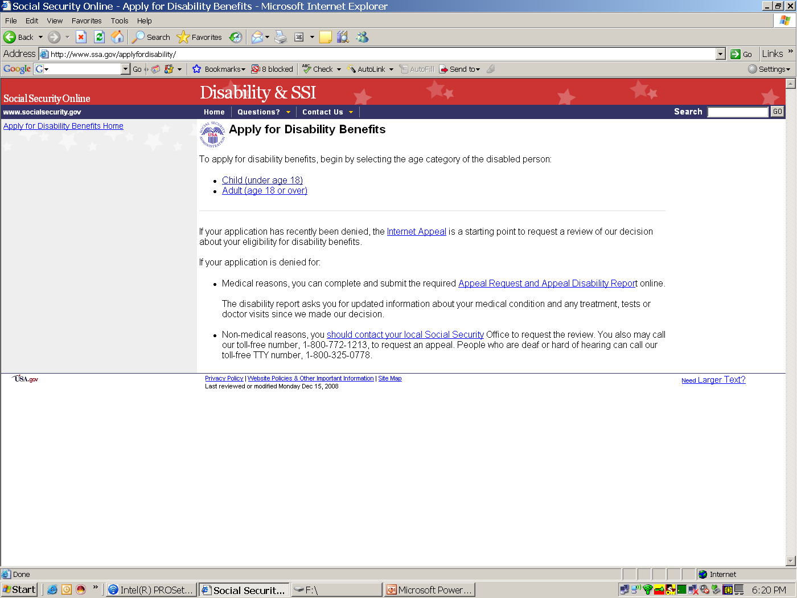
Begin Disability Process
Notes:
You can begin the process as a child or an adult, we’re going to look at the process of applying as an adult. If you inquired for your child before they turned 18 but maybe the parental income or resources were too high and they didn’t qualify. Once the child turns 18 we don’t deem parental income or resources so they may qualify.

Slide 22
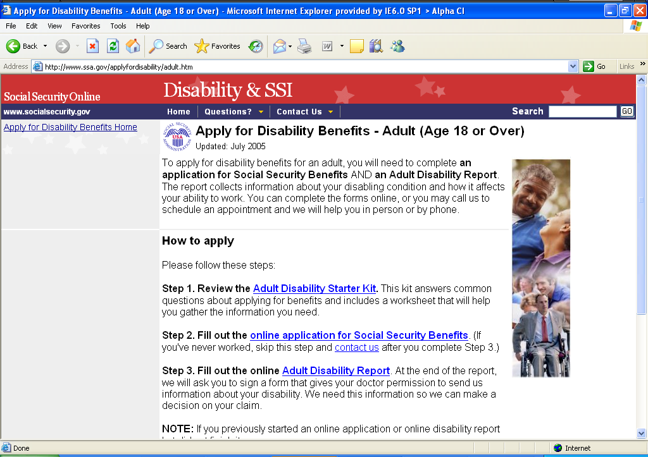
Notes:
There are two different things you can do on the website as part of the application process. You can apply for regular social security benefits or begin completing a disability report. There’s two benefit programs: regular social security benefits that require at least a $1,090 work credit. And then there’s SSI, the financially needs based program. Online, there is an application for regular social security for people who have work credit. The SSI application isn’t online yet. It’s a very complex process and we’re still working on putting it online. But this doesn’t preclude you form working on perhaps the biggest part, filling out the disability report online.

Slide 23
Notes:
There are different ways of going about this but I’m going to talk about the quickest, easiest way. And that is to begin filling out the adult disability report online. The Disability report is common for both programs, SSI and regular social security. Filling out the report online is way to go, even if you’re applying for SSI at the local office.

Slide 24
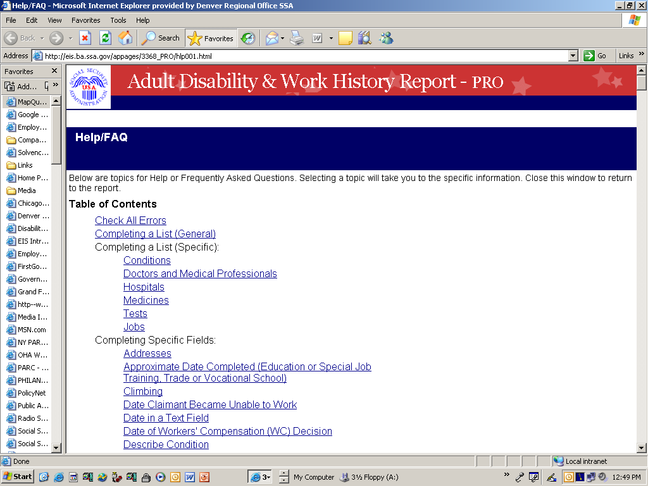
12 pages of topics available
Notes:
As you begin, the application online seems intimidating, it asks for a lot of information. It’s a little like a job application. You fill out basic info, like on a resume to get job, you’re fleshing out the information. But if you get stuck, there is help is in the FAQ section of the site which will let you get some guidance. So don’t be intimated by the mere quantity of information you have to fill out.

Slide 25
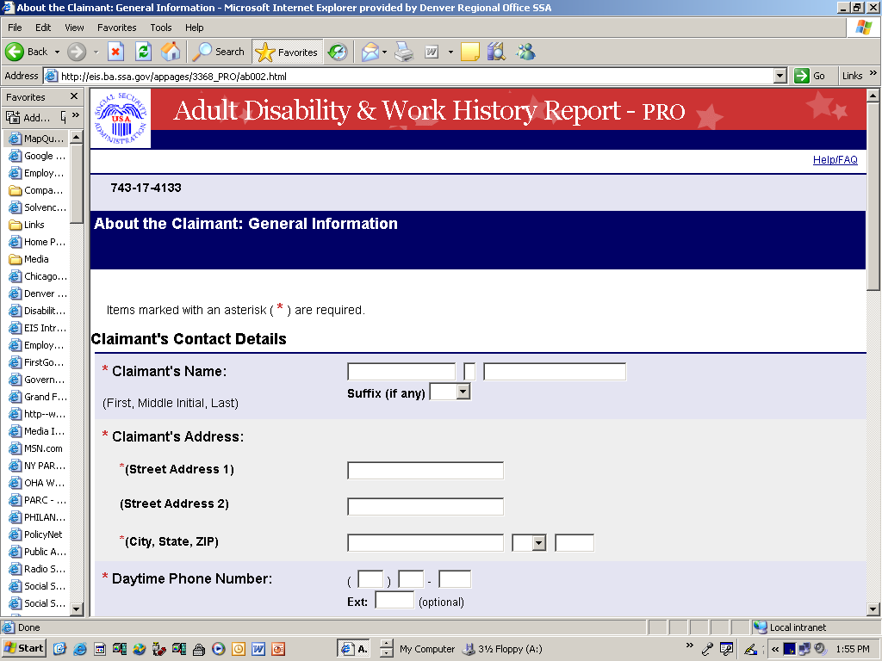
BEFORE
Notes:
To give you an idea of what it looks like as you begin, there’re a lot of pages of blank information. There’s a lot of information that you need to fill out. Here’s what it looks like when you’re just starting.

Slide 26
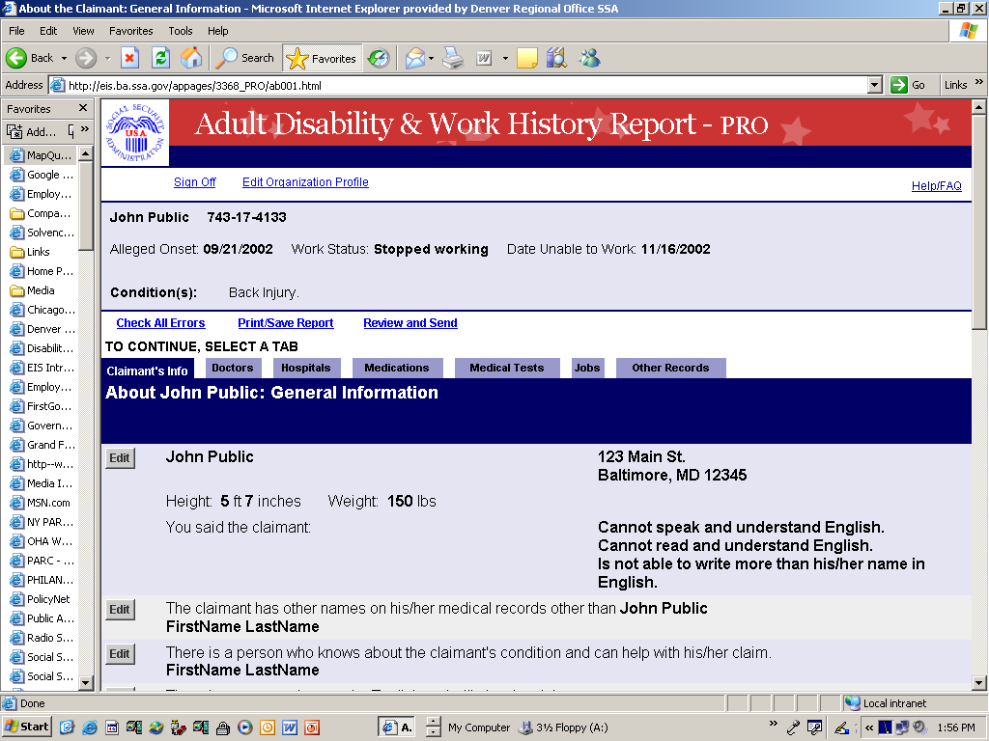
AFTER
Notes:
And here’s how it begins to look as you’re creating the disability report.
But the information you fill in begins to propagate. You can go back and change things as you need to.
For example, if you completed the doctor’s portion, filled in the name and contact information of the doctor with the most medical information about you , and now you’ve moved on the medications section. You’ve already filled in the list of medications and who prescribed them but you realize you forgot the name of the doctor from the last section. Then you can go back to that page, find the name you need, and go back to the page you were on to fill in the information. The point is, there are lots of easy ways to navigate the report as you’re filling it out.

Slide 27

Claimant Section
At the end of this section, you’ll get a re-entry number
You need it to return to the disability report anytime
before you submit it
Notes:
You also get a re-entry number shortly after starting the form. It’s kind of like an ATM pin number that allows you to go back in to the form at your convenience. So if you get tired and want to come back, you get a re-entry number.

Slide 28
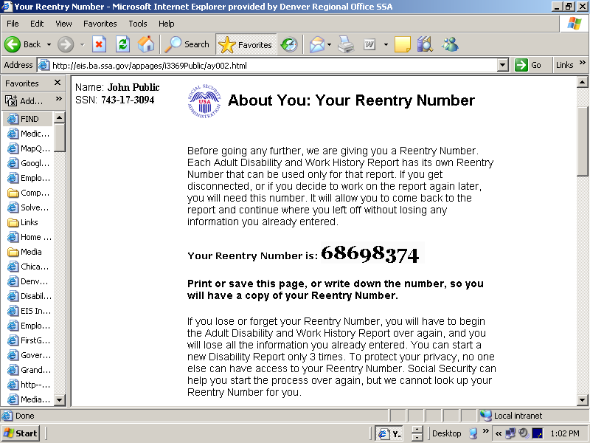
Notes:
You can write down the re entry number or print out. Then you can go back in, using that number, and pick up where you left off. You don’t have to do in one sitting. It’s really the best option. Then you can fill out the form at your own pace and convenience. You can fill in the information in a leisurely fashion.

Slide 29
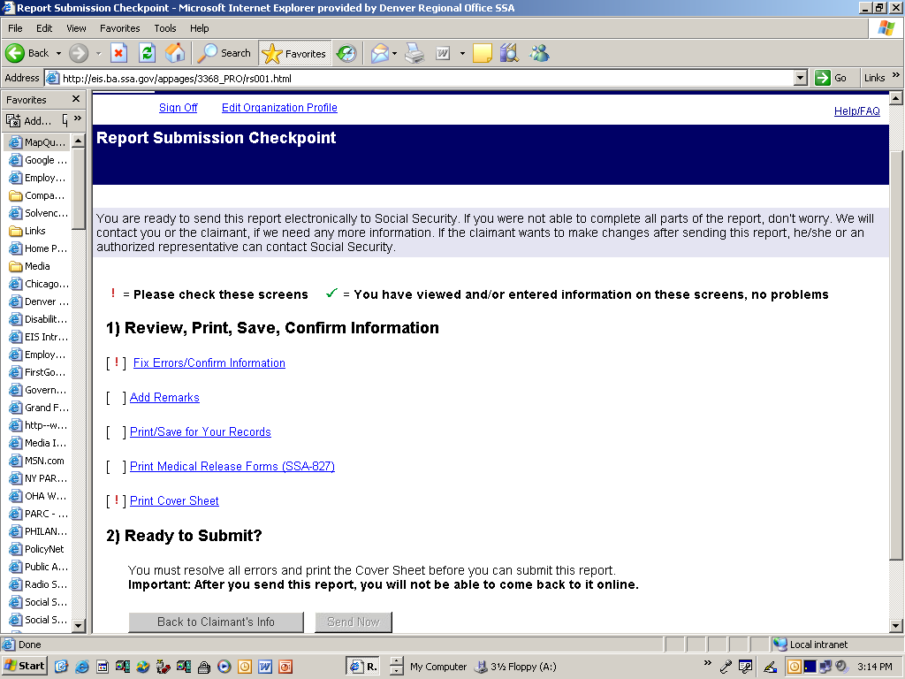
Notes:
At conclusion or completion, you can save the disability form for your own records. You can print it out or save it to a disk.

Slide 30
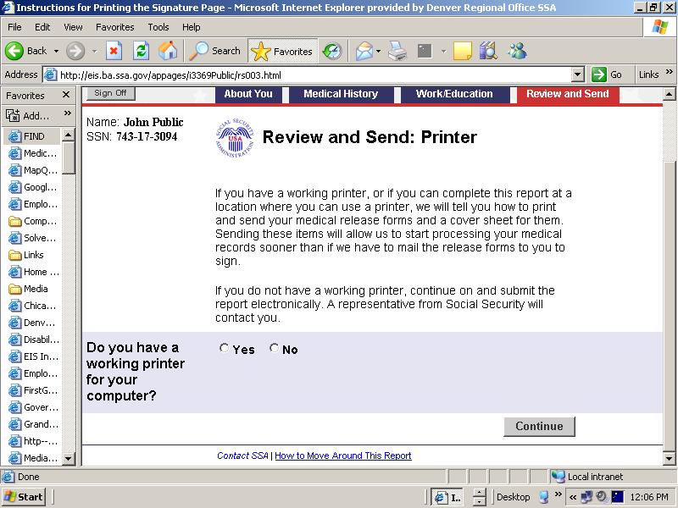
Notes:
The form also includes Medical release forms that have to be printed out in paper form, completed, and signed. We provide you with a cover sheet for these release forms so you know where they should get mailed back to. So, the disability report has two parts. There’s an online part and there are paper medical release forms that you have to fill out and mail back. There’s a release form for each medical source you list in the report.

Slide 31
Authorization to Disclose Information (SSA 827)
The SSA-827 gives permission to healthcare providers, schools and others to provide records to Social Security & the DDS.
It appears at the end of the online medical report -
Print it and complete it.
Sign and mail it to your Social Security office.
Notes:
The release form is called an SSA-827. If you have a dozen doctors, schools, clinics, etc… listed then you’ll get a dozen medical release forms that ask for basic information that will allow us to go to doctors and get medical information about you.

Slide 32
SSA Disability Tips
Assisting People with Disabilities File For SSA Disability Benefits *
You’re ready to help but...
Notes:
We have some tips that are available, they’re called SSA disability tips.

Slide 33
Blue Book
www.ssa.gov/disability/professionals/bluebook/index.htm
Notes:
Another resource available to you as you fill out this report is the Blue Book. It speaks in medical terminology. It explains what the requirements are to receive SSI, but using medical terminology. It explains what we need to see from a doctor’s exam in order for you to qualify for benefits. That way you can go a step or two further in providing information.

Slide 34
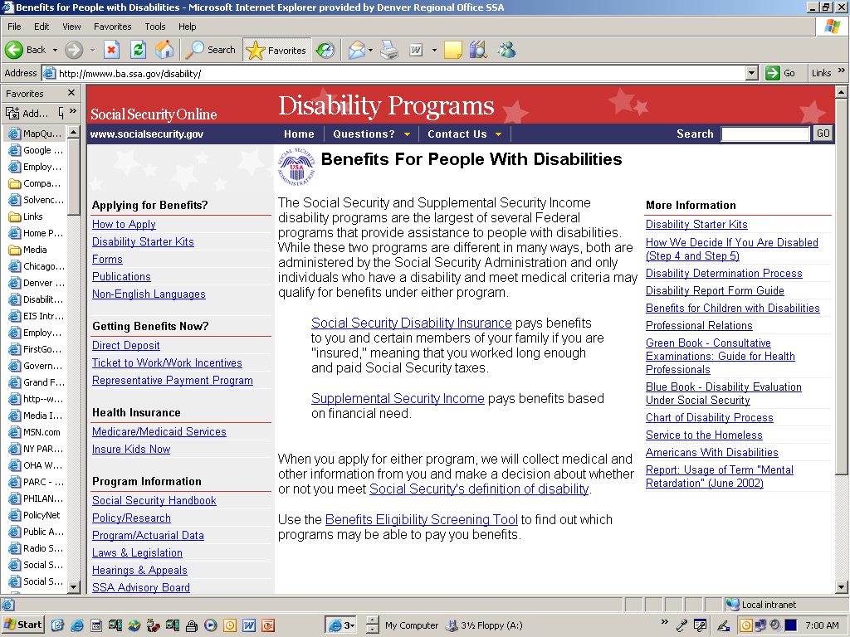
Notes:
It’s available on our website, under the disability tab.

Slide 35
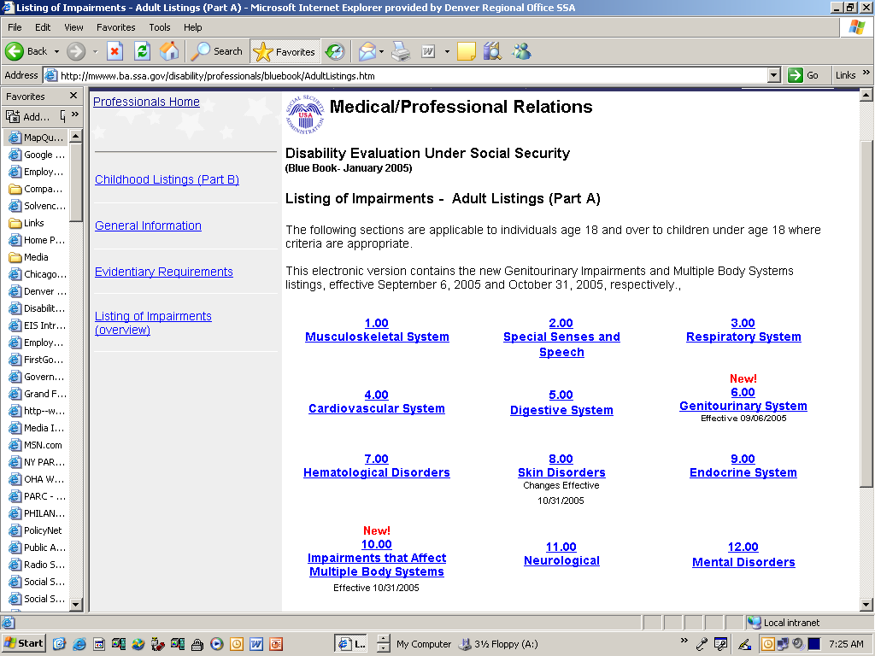
Notes:
Just an example, it shows the different body systems and you can drill down to specific examples. . For example, if you have emphysema the Blue Book will explain what the lung capacity requirements are to qualify for benefits.

Slide 36

i3368 PRO Navigation
“Report Submission Checkpoint” leads you through the final steps to complete your report; namely:
Review
Print
Save
Confirm
Submit
Notes:
Once you’re done with the disability report, you submit it to us electronically. Before submitting it, you can view the whole thing, edit it, print it out, save it, and then submit it to SSA. We receive it electronically immediately.

Slide 37
Advantage of Beginning Online
You can:
  Complete the application forms at
  your convenience
  Work at your own pace to complete the information
  Take advantage of online help
  Print a copy for your records before
  submitting them
Notes:
The advantages to filling out the form online, or at least starting it, are pretty evident. It allows you to work at your own pace, you’re not pressured, you’re thinking more clearly, and you’re building a better disability product. So please consider filing online, or at least beginning it online.

Slide 38
Red Book http://www.socialsecurity.gov/redbook/
Work Incentive
  Plan for Achieving Self-Support (P.A.S.S.).
  Student Earned Income Exclusion.
  ($1640/mo; $6,600/yr)
  Can’t afford to lose Medicaid? 1619B
  Ticket To Work
Notes:
Another resource available to you is the Red Book, and Melanie might talk a little more about this. It has a lot of work incentive information. If you’re on social security, you’re not supposed to be able to work, but SSA will keep saying ‘try out working.’ We don’t want you to get stuck on benefits if you want to try to work. So work incentives allow you to work and not lose all of your benefits. There’s the plan to achieve self support, or PASS plan. There’s the Student earned income exclusion that allows someone going to school to earn up to $640 or a little over $6000 annually with no reduction in SSI benefits; it gives you a chance to try out the job. There’s 1619B. Maybe we have to cut out your checks because the income is too much but we might still be able to certify Medicaid for medical coverage. There’s the Ticket to Work which is another motivator to working. These are things available to you that are designed by SSA specifically to encourage you to try to work without being disadvantaged. So if you have an adult child who is receiving benefits and you’re interested in this stuff, we have specialists who can talk to you about it.
I’m going to turn it over to Iris, she’s going to talk a little more about the development of the disability material that you’re doing online.

Slide 39

What Happens Next?
Disability Determination Services
  Obtains medical reports from doctors, hospitals, schools & others
  Analyzes all of the information
Notes:
I work for Social Security Administration Disability Determination Services and we handle adult and child claims. I’m a Professional relations officer, I don’t actually do claims but I assist with them and help resolve any problems that might come up. We’re a state agency and we have a Federal contract with the state. We take the information from your application form and write to the medical sources, school sources, and other sources to gather information about you. Forms are also sent to you by Disability Determination Services (DDS) and it’s important that you give us as much info as you can on these forms. The information on these forms may come from the person applying, their parents, teachers, friends, or others. All of the information is received and analyzed by the disability specialists. Sometimes the information we receive is incomplete or inconsistent. This might be resolved by calling your attending physician and getting a resolution. But sometimes we can’t do that so we’ll set up a one-time exam.

Slide 40

Medical Documentation Needed
Hospital records (Physical—one year; mental two years)
Outpatient/Clinic Notes
Psychiatric/Psychological Records
Laboratory Studies/Radiology/Pathology Reports
Treating Source Notes/Letter
School records—IEP, Speech Therapy, Teacher information
Notes:
40
This is the type of information that we need. Hospital records; for a physical impairment we need records one year back from impairment and for mental impairments we ask for two years back because we’re looking for a longitudinal history. Out patient or clinic notes; psychiatric or psychological notes; laboratory results, radiology, pathology; notes from your doctor saying you’re disabled, if he’s willing to write us a letter. We also look at school records; IEPs, speech therapy, teacher information.

Slide 41

Other Sources of Evidence
Social Service Agencies
VR Counselors
Teacher
Lay Evidence (used to assess functioning etc):
Family members, friends, clergy
Employer
Notes:
41
Other sources of evidence are social services agencies, VR counselors, and teachers. We may contact a neighbor if you listed them as a resource or someone who knows about the disability. We may contact family members, friends, clergy. If the child is working or you’re working, we may contact the employer.

Slide 42
Mental Conditions
Functional Areas Evaluated
Marked functional limitations in:
  Activities of Daily Living
  Social Functioning
  Concentration, Persistence & Pace
  Repeated episodes of decompensation, each of extended duration
  Marked-interfere seriously with ability to function independently, appropriately, effectively, and on a sustained basis.
  http://www.ssa.gov/disability/professionals/bluebook/12.00-MentalDisorders-Adult.htm
Notes:
We look at physical and mental condition. These are some mental conditions or functional areas we look at for evaluation. We look whether there’s marked functional limitations in activities of daily living, social functioning, concentration, persistence and pace. Whether there are repeated episodes of decompensation, each of an extended duration. Also, if there is marked interference with the ability to function independently, appropriately, effectively, and on a sustained basis.
42

Slide 43
Mental Residual Functional Capacity
Maintain concentration & attention at work.
Understand, remember and carry out instructions.
Respond appropriately to supervisors, co-workers, and usual work situations.
Cope with changes in the work setting.
Notes:
43
Some of the things we look at for mental functional capacity, what you or your child is capable of doing: Can you maintain concentration and attention; understand and carry out instructions; respond appropriately to co workers, supervisors, and customers in usual work situations; or cope with changes in the work setting.

Slide 44
Completing the Function Report
SSA -3373
Eight page generic form—covers physical and mental disabilities—need DETAILS.
DDS never sees you so provide us a “picture” of your day to day activities
Tie answers to your medical conditions
(For example, “Do you prepare your own meals”? Don’t just say yes or no. State—My depression makes me forgetful. I only prepare frozen dinners in the microwave. When I use the stove, I either burn the food or leave the burner on.
Notes:
I mentioned that DDS may send you forms in the mail and one that we will send you often is the adult function report. At the bottom of it you’ll see SSA form 33-73 and it’s an 8 page generic form that covers physical and mental conditions. We need details from you. DDS really never sees you. We’re only looking at forms and information sent in by others. We have to tie your answers to your medical condition. For example, one of the questions is “Do you prepare your own meals?” Don’t just say yes or no. Say why you can’t prepare your own meals.

Slide 45
Function Report Adult
SSA-3373
12. Meals
  Do you prepare your own meals? X Yes
  I heat food in the microwave. I am not allowed to use the stove. I left the burner on and the pot boiled dry. My mom puts the food in the fridge and writes a note with how long to cook and which button to push.
  Any changes in cooking habits since the condition began? Before head injury I did not forget things. I could cook on the stove
Notes:
I took one of the questions that’s on the functional report and elaborated. The more information you can provide the better picture the disability specialist gets of your ability to function and all of that is taken into account along with the medical impairment. For the question “Can you prepare own meals?” an example answer is “Yes, I heat food in the microwave. I’m not allowed to use the stove because it burned the pot last time I did it. It boiled dry.” These are just example of how you can give additional information so we get a better picture.

Slide 46
Why DDS Obtains
Consultative Exams (CE’s)
The evidence already received is not sufficient to support the determination.
Necessary evidence is not available from the treating source.
A conflict must be resolved
and DDS has been unable
to do so by re-contacting
the treating source.
http://www.ssa.gov/pubs/10087.html
Notes:
46
Remember I said I would explain more about consultative examinations. This does not cost you anything, it is at our expense. Sometimes the evidence we get from your doctor or school or other sources, isn’t sufficient to get a disability determination. SSA has the toughest disability requirements of all the agencies in USA. If you have a breathing problem but your doctor hasn’t done a Pulmonary functions study, we may send you out for that study so we can see what your lung capacity is. Or we may send you to a psychologist for testing if the school records aren’t sufficient to provide current testing. We do these exams when the necessary evidence is not available, when there’s a conflict that must be resolved but DDS hasn’t been able to resolve it but contacting your sources.

Slide 47
Speeding up the Process
How You can Help-1
Provide Contact Person–need name, address & phone #.
Need an English speaking contact if claimant does not speak English.
Report change of address/phone#, new treatment and new medical conditions.
Notes:
47
These are some hints you can use to speed up process. When you’re’ filling out the disability report when you’re applying for SSI, provide a contact person. And give us the name, address, and phone number for that person. It should be someone who’s familiar with your child and their condition. Also, report and changes of address, phone numbers, treatment, or medical conditions to us. Often, someone will change their phone number without notifying us and then we can’t get a hold of you to tell you if your appointment has changed or something else important has occurred. If we don’t have a good phone number for you, this means searching through the files to try to find another number.

Slide 48
Speeding up the Process
How You can Help-2
SSA-1696 Appointment of Representation
  Claimant must sign 1696 indicating who he/she is authorizing to represent them
  Assists with all aspects of the application
  Allows communication with SSA and DDS
  Receives copy of all correspondence sent to claimant
  SSA must approve representative’s fee
  Representative does not have to be an attorney
  http://www.ssa.gov/online/ssa-1696.html
Notes:
There are two ways that you can help. SSA has a 1696 appointment of representative form that you can fill out. This way you get copies of appointment letters and of the determination we’ve made. Most people who fill out this form are attorneys but you don’t have to be. Another way to help is to be listed as a contact person. Then you can call and provide information but you don’t have a legal basis for being involved in the determination.

Slide 49
Speeding up the Process -3
Supply copies of your medical records for prior 12 -24 months
Provide as much information as
possible re: treating sources
(Disability Report)
Release of Information Forms
(SSA-827)
Notes:
Another way you can speed up process is to supply us copies of your medical records for the prior 12 to 24 months. Also, provide as much information as possible when you’re filling out the disability report form. Give us information about treating sources: address, phone number, doctor you saw, medications, what you were treated for, and any additional details. Also, make sure you fill out a release of information form. There are no medical sources that will release information to us without this form. If you have child as young as 13 some facilities, like mental health, will also require the child to sign the release form. So it’s better to always have the child sign too.
49

Slide 50
Speeding Up the Process-4
Inform DDS of transportation or other problems that may interfere with attending a Consultative Examination
Keep the appointment
If unable to keep the appointment, inform DDS immediately.
Notes:
If you get a consultative exam appointment and you find out that you can’t make it or you have another doctor’s appointment that same day, call the DDS. Call them immediately and inform them of any problem that will interfere with attending you attending you appointment.
50

Slide 51

Evidence from Claimant
ALWAYS RESPOND TO REQUESTS FOR EVIDENCE—If you do not understand the request or need more time, CALL DDS
Activities of Daily Living (SSA 3373)
Description of all jobs performed during the past 15 years (SSA 3369)
Pain and other symptoms
Other information on case-by-case basis
Notes:
51
If you get a request for information from the DDS, whether it’s forms, an appointment letter, a letter asking you to call, etc...please always respond to request for information. I f you don’t understand what is being asked or you need more time, be sure to call. The phone numbers you need will always be listed on the letter.
If we send you the activities of daily living form, give us as much information as possible. If you’ve been working, describe this work. If you have pain or other symptoms, describe them.

Slide 52
Appeal Process
You will receive letter explaining initial decision
If you do not agree with decision you have 60 days to appeal.
Request for hearing can be done online at https://secure.ssa.gov/apps6z/iAppeals/ap001.jsp
Notes:
If you are denied your claim for benefits, you can appeal. You can appeal online. So if for some reason we deny your claim, you have 60 days to file an appeal.

Slide 53
Begin Disability Process
Notes:
You can find do file the appeal right here online. We don’t want to look forward to denials, but it happens.

Slide 54

Learn More About SSA Disability
Go to www.socialsecurity.gov to obtain
Disability Benefits
Supplemental Security Income (SSI)
  Benefits For Children
  with Disabilities
Forms and Publications
Notes:
There’s a wealth of information on our website. There’s our home page, forms and publications. If there’s a form you need, you can get a lot of it online.

Slide 55
www.socialsecurity.gov
Notes:
There’s a lot of information on here (on the website). Today we talked primarily about extracting information and applying for disability online. I think the final thought I can leave with is this. If you’re applying for benefits, regular or SSI, you should begin the disability report online because it saves time and you’ll do a better job.

Slide 57
Tips
Gather Information Early
Adult Disability Starter Kit
“Social Security Blue Book” online
Know what it means to be disabled under Social Security
Be thorough – sign and date releases and forms; attend scheduled doctor appointments
Make Copies; Get Receipts
A person could be working through this process! You don’t have to stop your life.
Notes:
Gather information early. If you or your child are turning 18 or will be in 3 months, don’t wait 3 months to start gathering information. Gather everything ahead of time and have it ready to go.
One way to help you organize everything is the adult disability starter kit. You can access it from the website. There’s a link on “adult 18 and over” tab and one of the first steps links to this kit. This isn’t a kit you fill out and turn back in but it is a great way to get started and get organized. It goes through a list of the records you need to turn in, there’s a checklist you can print out. There’s a medical and work history sheet which will help you answer questions you might get from a social security representative.
3. Use the Social Security blue book online. It gives you idea of what SSA is looking for. Sometimes people have family doctors for years and years and they may work for you. But you can get into this book and copy and paste the part that pertains to you. Then take that in to your doctor and see if they’ll put that in their notes. I’m not going to say it happens always that way, some are willing to do it and some are not. But it can’t hurt to ask.
4. Next tip is to know what it means to be disabled under social security. You’re getting a head start by watching this presentation. A lot of people say “Well, my doctor says I’m disabled, so I should be able to get disability benefits.” But it’s not just a medical diagnosis, as these guys mentioned. It’s really showing what your ability to work is and that you a have limited ability. You can get this information from a benefits planner.
5. Next, be thorough. Read everything you get and do what it says. If something says sign and date, then do that. Don’t just sign it and forget the date. I’ve seen cases be denied because someone didn’t date the release of information forms. Don’t just skim the things you receive, read each step because it’s all important. And those letters that you get from DDS, that’s important, very important. Follow the instructions and do what they’re asking and do it in a timely manner. I’ve had people come in who threw out a letter they received, don’t do that. Keep things and open them up; go over the information with a benefits planner.
6. And the other thing is, if you send in information, always make copies of what you send in. That way you can refer to what you have in front of you when you’re talking to SSA. You can also have proof that you turned things in. Remember that the whole time you’re on benefits.
7. Last, you don’t have to quit your life to apply for benefits. You don’t have to quit work and stop everything; you can be working through this whole process.

Slide 58
A Family’s Experience
Getting started – initial contact and on-line process
Community resources and assistance (DDRC, parent support groups)
Interview process (phone & in-person)
Interview follow-up; Gathering documents
SSI Meeting
Recap & what we learned
Notes:
So I started this process in the end of January, I called DDRC and they gave me the phone number. I called and spent a lot of time on phone, I had to push lots of buttons and answer a lot of questions before talking to a human. I probably spent more than an hour on the phone. They have me the information to do the application online, which I did. It took me about 2 hours and I did it all in one sitting because I didn’t want to go back to it over time. It took a lot of looking back. He was a preemie so I went back really far, to when he was a baby, which I probably didn’t need to do, but I did. He had a lot of doctors. So I gathered all of that information, address, phone numbers, and all the things they’ve done over the last 18 years. It took quite a while.
I also contacted parents through support groups and asked if they did it online, if they did a phone interview or in person interview. I tried to figure out what I should expect. The parents I talk to didn’t do the application online. I submitted it in February and I was told by many parents that I did it too early and I’d be denied and set back 6 months so I thought I blew it.
I did phone interview in February and they said they needed to look at my income so we got off the phone and they did that. Then we set up in person interview for the first week of march. I opened him up a checking account at our bank, just for $25. And I got him a debit card so they had somewhere to put his check. I opened it up in my name for him.
Then, I wrote all of his doctors letters asking them to write a letter saying his disability was from birth and that it limits his ability to work and to work for long periods of time. I got letters from 3 of his doctors. I got medical records from Children’s Hospital and Rose Medical Center. I thought I had to go all the way back, but you only need to go back one year, so remember that.
In my situation, with Skyler, it’s obvious that he has a disability and the letters from his doctor were sufficient. I signed one medical release form so the representative could go to Children’s for information. I didn’t need to bring in pages and pages of records which is good because that can be expensive and lengthy. It would’ve cost $200 to get everything from Children’s. In our case, I didn’t need lengthy records, just the doctors’ letters.
I wrote up a rental agreement with him. He and I signed it and agreed on the amount of $650 monthly. That’s our house payment and food divided by 3. I’m excited to finally have him paying. But we’ll see what he thinks when it really happens. He doesn’t like to give up money.
We went to an SSI meeting. It went well and took about 30-40 minutes, probably because we did all of the work online prior to the meeting. She took the letters and copied them and we had to sign stuff. I’m his representative payee so they had to ask me a bunch of questions. It went smoother and better than I expected. We were lucky and I’m glad it went well. He was approved immediately because of his disability.
April is his first full month of being 18 and he’ll receive checks then. For me as parent, it’s a huge thing because it’s not what I had expected us to be doing when he turned 18. Emotionally it was huge but my husband didn’t really care. I will say that when you go through the school thing, you try to look at strengths and making them independent. You try to look beyond the disability. With this, you have to focus on how disabled they are and how limited they actually are. So, for me that was a very difficult step. The word incapacitated is a huge word for me. It was an emotional thing but now that I’ve seen this training and seen how you do this thing online, it is a piece of cake. The meeting went well and that really reduced my anxiety about the whole situation. And that’s all I have to say.

