Slide 1

Accessing Insurance
& Health Care
Presented by:
Genni Williams & Corinne Gray
The Arc JCC&GC

Slide 2
Overview of Healthcare
& Insurance
  Overview
What we’re going to discuss
  Introduction to insurance
  How do you acquire insurance?
  What insurance do I have?
    Background on Medicaid
  How to “access insurance” – using insurance to pay for healthcare
  When you get stuck
  Your responsibilities

Slide 3
  Introduction to Insurance
Introduction
to Insurance

Slide 4
Introduction to Insurance
  Introduction to Insurance
How insurance works
Basic insurance terminology
Public vs Private Insurance

Slide 5
How insurance works
  Introduction to Insurance
Insurance provider:
  pools premiums of insureds to cover costs of services
  determines what services/benefits are covered or excluded
  goal is to minimize healthcare costs

Slide 6
Public & Private Insurance
  Introduction to Insurance
Public insurance is paid for by government/taxpayer dollars. Differentiating public from private insurance is simply a matter of funding.
Private Insurers
  Blue Cross Blue Shield
  Kaiser Permanente
  United Healthcare
Public Insurers
  Medicaid
  Medicare
  CHP+ ???

Slide 7
Public & Private Insurance
  Introduction to Insurance
Regardless of how an insurance program is funded, whether it’s public or private, there are some basic things that all insurance has in common:
  Eligibility Guidelines
    Public – Depends on Program
    Private – Depends on Insurance Company and how you are accessing insurance (individually or employer funded)
  Language, Terms and Definitions
    Somewhat Specific to each Insurance Provider
  Laws and rules which guide services
  Procedures
  Benefits
  Precedence (history)
  Appeals Process

Slide 8
Basic Insurance Terminology
  Introduction to Insurance
Private Insurance | Public Insurance (Medicaid/CHP+)
Eligibility | Eligibility
Benefit | Benefit
Copayment | Copayment Exempt
Medical Necessity | Medically Necessary
Open Enrollment | Open Enrollment
Prior Authorization | Prior Authorization Request (PAR)
Durable Medical Equipment (DME) | Durable Medical Equipment (DME)
Case Management | Case Management
Ombudsman | Ombudsman/State Regulatory Commission
Maximum Lifetime Benefit (Cap) | Rehabilitative
Deductible | Amount, Duration, Scope, Lifetime
Pre-Existing Condition
Risk
Premiums

Slide 9
  How to become insured
How do
I become insured?

Slide 10
How to become insured
  How to become insured
Enrollment Process
  Eligibility based
  Premiums for most private insurance; might be paid by an employer
Public
  County Dept. of Human Services
  Certified Application Assistance Sites (CAAS)
Private
  Employer
  Individually purchased
  Self-funded plans

Slide 11
  What Insurance do I Have?
What insurance
do I have?

Slide 12
What insurance do I have?
  What Insurance do I Have?
Name of insurance company
Locating your plan documents
Reading your plan documents
  What’s covered?
  What’s included?
  What are my out-of-pocket costs?
  What are my limits?
  What if I’m still not sure?

Slide 13
Minimum Service Coverage
(Essential Health Benefits)
  What Insurance do I Have?
Ambulatory patient services
Emergency Services
Hospitalization
Maternity/newborn car e
Mental health/substance abuse
Prescription drugs
Rehabilitative & habilitative services and devices
Laboratory services
Preventive and wellness care/chronic disease management
Pediatric services, including oral and vision care

Slide 14
Private Insurance
  What Insurance do I Have?
Practice reviewing three plans of class participants, using previously instructed terminology to quickly find key components

Slide 15
  What Insurance do I Have?
What’s the
big deal
about Medicaid?
(Healthy Communities)

Slide 16
Public Insurance: Medicaid
  What Insurance do I Have?
The program known as Medicaid became law in 1965 as a jointly funded cooperative venture between the Federal and State governments to assist States in the provision of adequate medical care to eligible needy persons

Slide 17
Public: Medicaid Funding
  What Insurance do I Have?
Currently, the federal government adds $1 to every $1 in the state of Colorado’s Medicaid budget
In some poorer states the federal government may add up to $1.50 for every state dollar budgeted

Slide 18
Public: Medicaid
  What Insurance do I Have?
  With that funding and within broad national guidelines set by the Federal government, each state:
  Establishes its own eligibility standards
  Determines the type, amount, duration, and scope of services
  Sets the rate of payment for services and
  Administers its own program

Slide 19
Public Insurance: Medicaid
  What Insurance do I Have?
Thus, the Medicaid program varies considerably from state to state, as well as within each state over time.

Slide 20
Public Insurance: Medicaid
  What Insurance do I Have?
HOWEVER, Medicaid coverage for children is unique because, in addition to state-defined services, children also receive the EPSDT benefit package mandated by the federal government.

Slide 21
Public Insurance: Medicaid
  What Insurance do I Have?
EPSDT: Early Periodic Screening, Diagnosis, and Treatment
Federal benefit package administered in partnership with each state
Extends additional benefits beyond state program for most Medicaid-enrolled children aged birth through 20

Slide 22
Public Insurance: Medicaid
  What Insurance do I Have?
Why does the federal government fund EPSDT?
Money
If health problems are addressed earlier, the government saves money on complex and costly treatments down the road

Slide 23
Public Insurance: Medicaid
  What Insurance do I Have?
It’s not only about low-income
Your coverage depends on how you qualified for Medicaid

Slide 24

How to qualify for Medicaid
(or getting into the Medicaid House)
  What Insurance do I Have?
Income eligibility
SSI
Child Welfare
Waiver programs
Once you’re in the house, you have full access to the state Medicaid benefits, and children have the added benefit of EPSDT services.

Slide 25

Medicaid: Income Eligibility
  What Insurance do I Have?
https://www.colorado.gov/pacific/hcpf/colorado-medicaid
Based on Modified Adjusted Gross Income (MAGI). The use of MAGI standardizes income eligibility rules across all states.
You may qualify if you fall under one of the following categories and meet the income guidelines:
  Children ages 0-18 with household income under 260% Federal Poverty Level (FPL)
  Pregnant women, over the age of 19, whose household income is under 260% FPL
  Parents and Caretaker Relatives (you must have a dependent child) whose household income does not exceed 133% FPL
  Adults without dependent children whose household income does not exceed 133% FPL

Slide 26
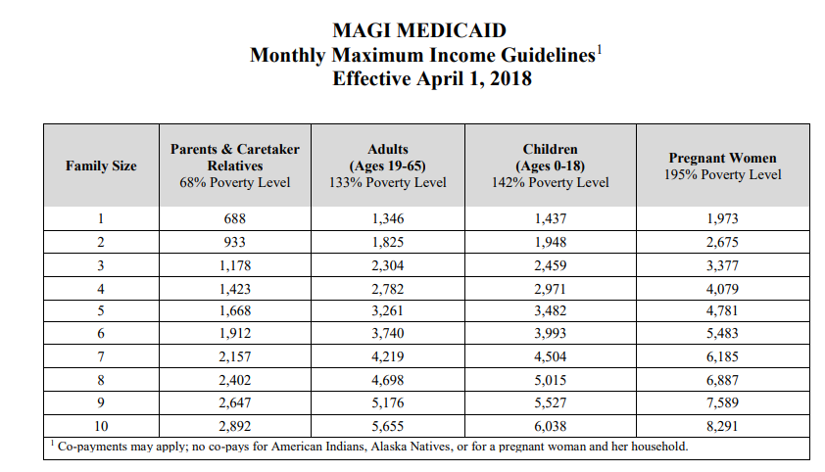
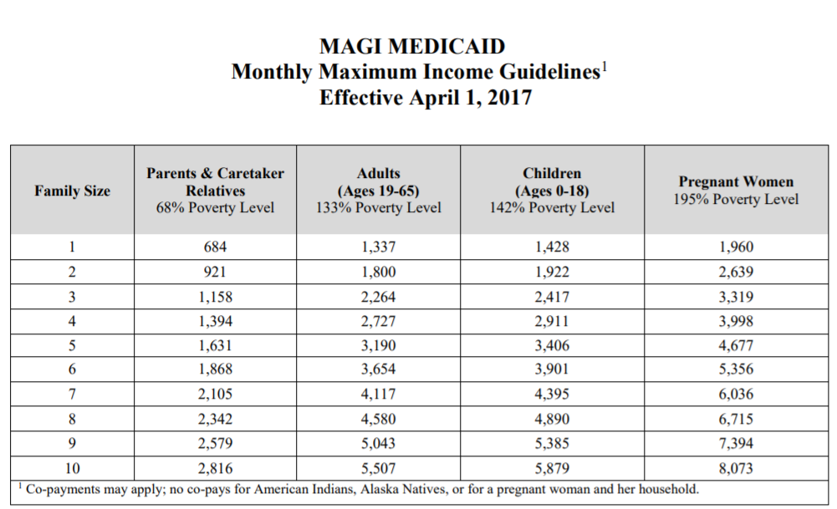
Medicaid: Income Eligibility
  What Insurance do I Have?

Slide 27
Medicaid: SSI Eligibility
  What Insurance do I Have?
SSI: Supplemental Security Income
To be eligible for SSI, you must meet both of these criteria:
  Income-based eligibility
    Under 18 includes parent income
    Over 18 is individual’s income only
  Social Security’s definition of disability
Once you are found SSI eligible, still have to separately apply for Medicaid
https://www.ssa.gov/ssi/

Slide 28
Medicaid: Child Welfare Eligibility
  What Insurance do I Have?
Youth currently in foster care system
Some children adopted through foster care system will maintain Medicaid after adoption
Homeless and unaccompanied youth
Kinship situations (i.e. familial care)

Slide 29
  What Insurance do I Have?
But we don’t
meet these requirements!
(Don’t despair!)

Slide 30

Medicaid:
HCBS Waivers (the garage)
  What Insurance do I Have?

Slide 31
Medicaid: HCBS Waiver Eligibility
  What Insurance do I Have?
The Home and Community Based Services (HCBS) Waiver programs are designed for children and adults with significant healthcare needs who otherwise don’t meet eligibility requirements. They can access Medicaid through waivers, which waive the traditional eligibility rules.
Each waiver has its own eligibility criteria and a finite amount of funding. Some waivers have enrollment limits, which means there could be waiting lists.
Like EPSDT expands Medicaid benefits for children, waivers expand benefits for eligible recipients.
WAIVER
SERVICES

Slide 32
Medicaid: HCBS Waivers
  What Insurance do I Have?
Waivers are funded through
  The state department of Health Care Policy & Finance (HCPF)
  Federally through the Centers for Medicaid & Medicare Services (CMS)
HCPF delegates the administration of some HCBS waivers to CCBs (!!)
Visit the HCPF web site for more information: http://www.chcpf.state.co.us/
For more information on specific waiver criteria, review supplemental presentation in online classroom.

Slide 33
Medicaid: HCBS Waivers
  What Insurance do I Have?
Applying for waiver-based Medicaid coverage:
Contact your county’s Single Entry Point (SEP):
  Human Services (DHS) office or
  Community Centered Board (CCB)
The SEP will establish eligibility according to existing guidelines

Slide 34
Medicaid: Special Situations
  What Insurance do I Have?
Dual Coverage Public & Private
Health Insurance Buy-In (HIBI)
  A program where Medicaid pays your health insurance premiums to prevent you from having to be fully insured through Medicaid
Medicaid Buy-In
  You have private insurance but it won’t cover your child’s needs
  You don’t qualify for Medicaid through traditional routes
  You can purchase “supplemental” coverage through Medicaid
    Medicaid would rather you pay them for partial coverage than have to fully insure your child and bear all costs

Slide 35
What Medicaid Covers
  What Insurance do I Have?
By now, hopefully you have some basic understanding that Medicaid benefits are somewhat variable.
Different coverage/benefits are generally related to how you became eligible for Medicaid.
  Adults – Basic Medicaid State Plan
  Children – Basic Medicaid State Plan and EPSDT benefits
  HCBS Waivers
    Adults – Basic Medicaid State Plan and specific Waiver benefits
    Children – Basic Medicaid State Plan and EPSDT and specific Waiver benefits

Slide 36
Phew! We made it through Medicaid basics!
Now back to understanding your coverage.
  What Insurance do I Have?

Slide 37

Understanding Insurance Exclusions
  What Insurance do I Have?
Exclusion apply to both public and private insurances
  EXCEPT: Children’s Medicaid currently has no exclusions because of the EPSDT benefits
The restaurant
The menu
Looking back at your plan docs:
  What’s excluded in your plan?

Slide 38
What is Medical Necessity?
  What Insurance do I Have?
Although the concept is universal in health insurance, the term Medical Necessity has specific meaning in the context of Medicaid.
Although EPSDT does not have exclusions, services must meet the criterion of Medical Necessity.
EPSDT 8.280–8.281.01(B)
  Medically necessary, or medical necessity, shall be defined as a Medicaid service that will, or is reasonably expected to prevent, diagnose, cure, correct, reduce or ameliorate the pain and suffering, or the physical, mental, cognitive or developmental effects of an illness, injury, or disability; and for which there is no other equally effective or substantially less costly course of treatment suitable for the child’s needs.

Slide 39
  How Do I Use My Insurance?
How Do
I Use My Insurance?
(Access Healthcare)

Slide 40
Using Your Insurance
  How Do I Use My Insurance?
To recap:
  You know how to
    determine what insurance you’re eligible for
    apply for insurance
    Understand your benefits, exclusions, and costs
And now you need to USE your insurance.
  Find a doctor
    Recommendations
    Google
    HCPF list of Medicaid providers
    CCHA for behavioral health
    Call around
  Choose a doctor
    Tip sheet on questions to ask a new provider
  Make an appointment

Slide 41
  When You Get Stuck
When You Get Stuck

Slide 42
Examples of Getting Stuck
  When You Get Stuck
Your insurance denies coverage of medically necessary:
  Testing
  Therapies
  Services
  Equipment
Your providers are not meeting your needs
Impenetrable bureaucracy
Somebody makes a mistake
Lack of available providers

Slide 43
First Steps for Unsticking Yourself
  When You Get Stuck
Your providers are not meeting your needs
  Review documentation and make your case
  Try a different communication approach
  Change providers
Impenetrable bureaucracy
  Become a squeaky wheel
  Contact provider administrators
  Use your resources to identify a chain of command or a backdoor option
Somebody makes a mistake
  Address it head-on
Lack of available providers
Appealing Denials

Slide 44

Appealing Your Denial
  When You Get Stuck
Always get your denial in writing!
Why?

Slide 45
Appealing Your Denial
  When You Get Stuck
Think about:
  Medical necessity: Why is this service needed?
  Cost: what future costs will be saved by having this service now?
  Safety: what future costs will be saved by having this service now?

Slide 46
Appealing Your Denial
  When You Get Stuck
Prepare for making the call to your insurance company:
  Have the PAR, denial or problem documents in front of you when you call.
  Full Name
  Patient ID #
  Date of Birth

Slide 47
Appealing Your Denial
  When You Get Stuck
Take notes during the call
  Date and time of call
  Full Name of insurance representative
  Phone number and extension of insurance representative
  Ask for a response in writing if it is about benefits

Slide 48
  Parent Responsibilities
Parent Responsibilities

Slide 49
What you need to do
  Parent Responsibilities
Know what you’re eligible for
Understand your plan and the language used in your plan
Understand the roles and motivations of insurance companies and providers
Know how to address conflicts
Use appropriate protocols when you disagree
Keep organized records
Filter information
Keep your family and your needs and goals at the core of all decisions

Slide 50
Record-keeping
  Parent Responsibilities
Good record keeping will
  Save you time!
  Improve the care you receive
Create a Care Notebook
  It’s cheap and easy
  Organize by areas of need or medical specialty
  Include a medication list
There’s an APP for that
  My Chart
  ChartSpan

Slide 51
Filtering Information
  Parent Responsibilities
Remember to evaluate all information as to whether it’s appropriate or applicable to your situation
Reminder:
  Parents are the ___________!
  The Internet is the __________!

Slide 52
What does your family need?
  Parent Responsibilities
People keep telling me to…
Think about your family’s needs
  Do recommended services meet those needs?
  Will the service make your family’s life more or less stressful?

Slide 53
The End!
  Wrap-Up
Don’t forget to check out more resources in online classroom!
Who can I call for help?
  Insurance Commission
  Family Voices of Colorado
  Colorado PEAK web site
  Medicaid: Gina Robinson
    Program Administrator, Children’s Medicaid (State)
    Gina.robinson@state.co.us
    303.866.2267

