Slide 1
Adult Life: Understanding Community Supports Recreation and leisure, transportation, housing. Tips for using resources to reach your goal

Slide 2
Session Objectives
Understand the role of utilizing community supports in place of or in supplement while waiting for government services.
Where to go in Jeffco for
activities after high school

Slide 3
Community
For the purpose of this training Community is defined as:
Resources available outside the traditional government system
Resources available where you live in your community
Tonight’s community representatives are a small sample of the variety and breadth of resources available for Jefferson County families

Slide 4
Community Support Categories
Recreation/Leisure
Housing
Transportation
Technology
Social/Friendship
Independent Living
Notes:
Things to think about, to get you started. What will you do with out the traditional supports, need a plan a schedule, wants to know what to expect, does not like the holes, creating the schedule is a lot of work, ever changing, constantly re-evaluating, interests change, seasonal.

Slide 5
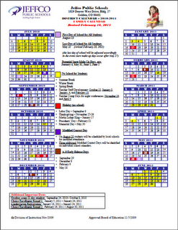
Reflection-make it personal
My child will have a good life after high school if……
Notes:
WORKSHEET—mention that we will have a panel at the end about these areas...

Slide 6
Youth Perspective
Tell us about
Futures Plan (PATH)
Education plan (IEP)
Vocational Training
Job Search
Sports/Recreation
Neighbors
Learning Independence
Transportation

Slide 7
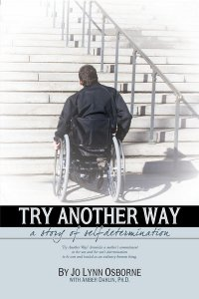
Parent Perspective
Try Another Way
By Jo Lynn Osborne

Slide 8
Transportation Resources
DRMAC
http://www.drmac-co.org/
Mailing Address: 190 E. 9th Ave., Ste. 440 Denver, CO 80203
Phone Number: 303-861-3711

Slide 9
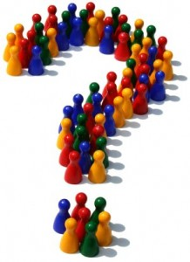
Questions for Community Representatives
What services/programs/support do you offer?
Do you have specific eligibility requirements, such as type of disability, financial issues, age, geographic location?
Is there an application or referral process?
Location & Contact Information
Is there a cost?
What’s the best way for families to get more information about your organization?
Information available at resource table

