Slide 1
Self-Advocacy
An Introduction

Slide 2
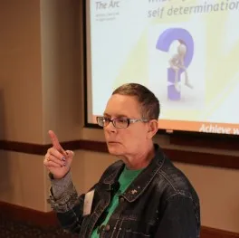
What is Self-Advocacy?
Fundamentally, self-advocacy is about people with disabilities speaking up for themselves. Although self-advocates may seek support from others, they are entitled to be in control of their own lives.

Slide 3
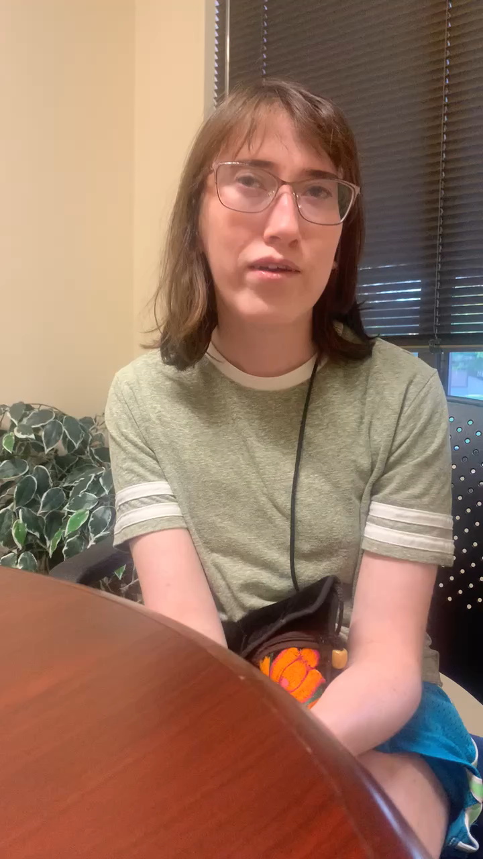
What does self-advocacy mean to you?
Molly Kirkham
President of People First and SFO
Active Member of The Arc—Jefferson, Clear Creek & Gilpin Counties

Slide 4

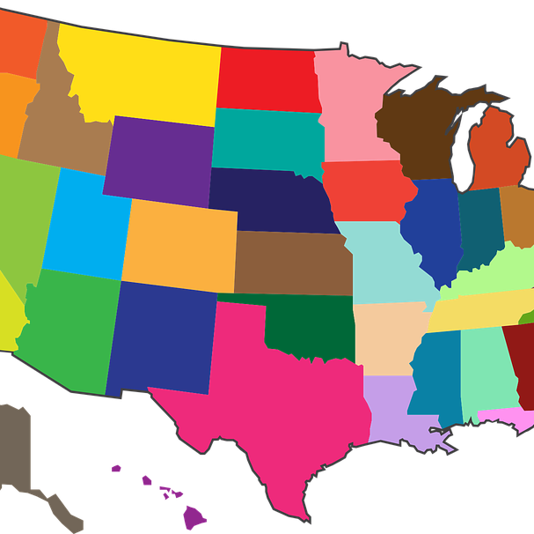

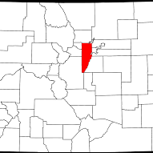
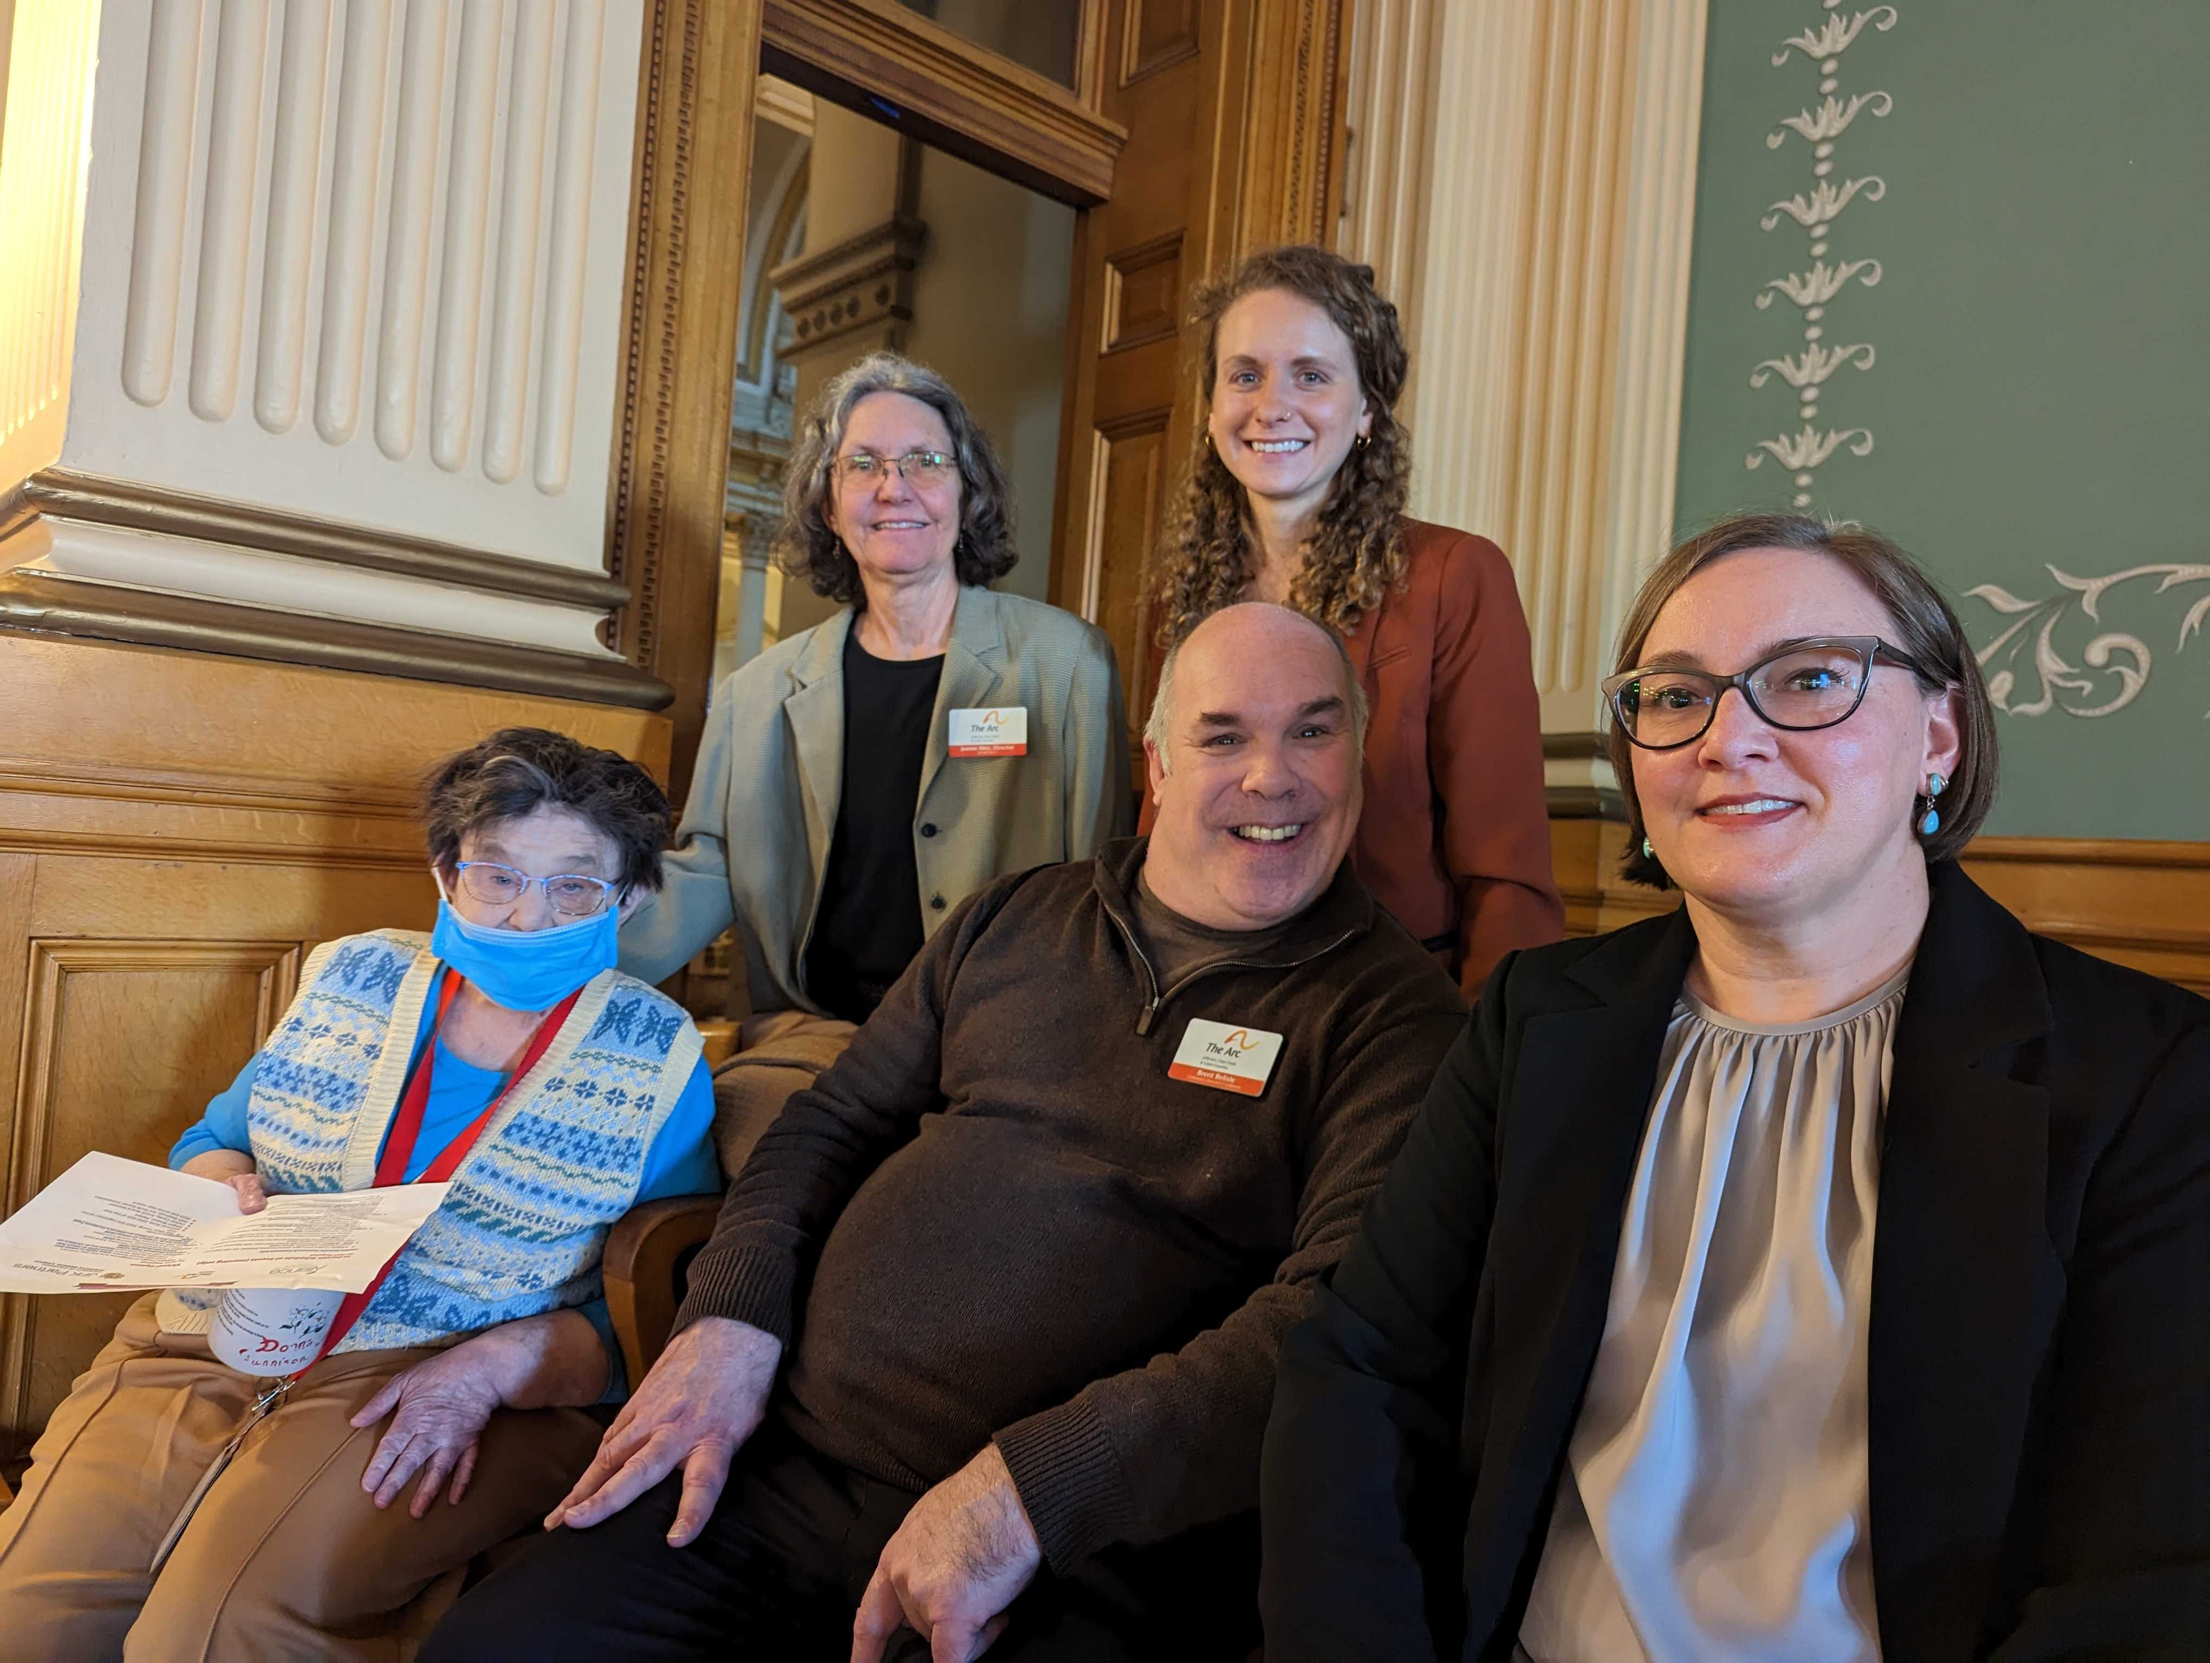
Self-Advocacy happens at many levels:
Global
National
State
Local

Slide 5

National:
About SABE
“Self Advocates Becoming Empowered (SABE) is the United State’s national self-advocacy organization. We are a national board of regional representatives and members from every state in the US.
SABE Board and Executive Committee members represent specific regions within the United States.”
SABE Website

Slide 6
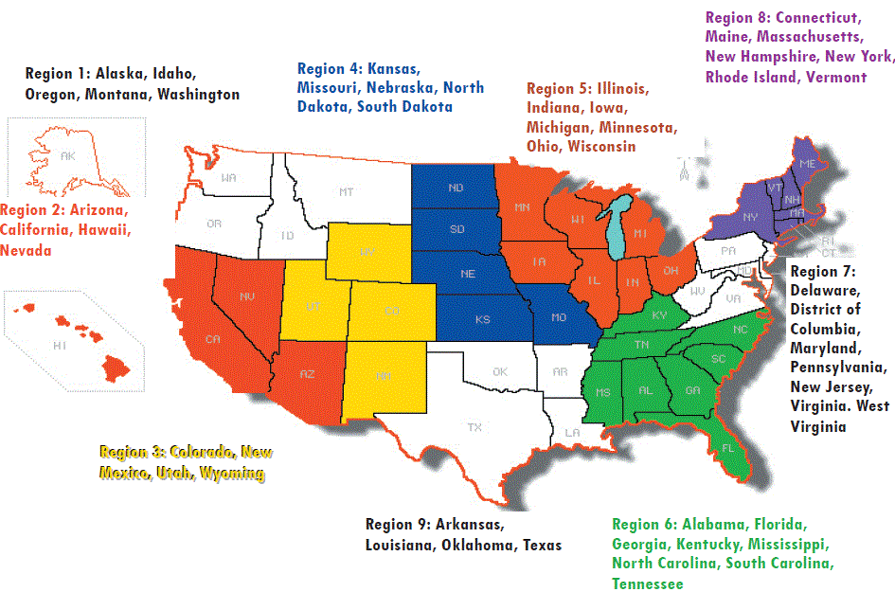
SABE Regions
SABE Website

Slide 7
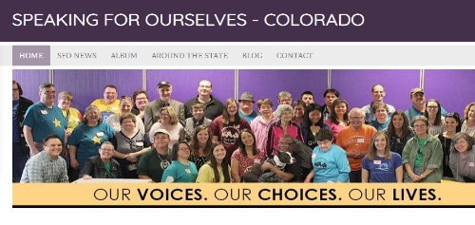
State:
Speaking for Ourselves (SFO):
“We are a statewide grassroots organization of people with disabilities who want to SPEAK FOR OURSELVES on issues that involve and affect us. People First chapters from all over Colorado join Speaking for Ourselves to make our voices stronger.
We talk with each other by conference call each month and we meet quarterly in various places around the state. We have been learning our rights and learning to Speak for Ourselves to make sure our rights are not overlooked!”
Visit the SFO Website

Slide 8
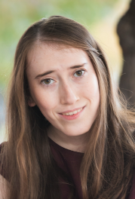
Current President of SFO:
Molly Kirkham of People First Jefferson County

Slide 9

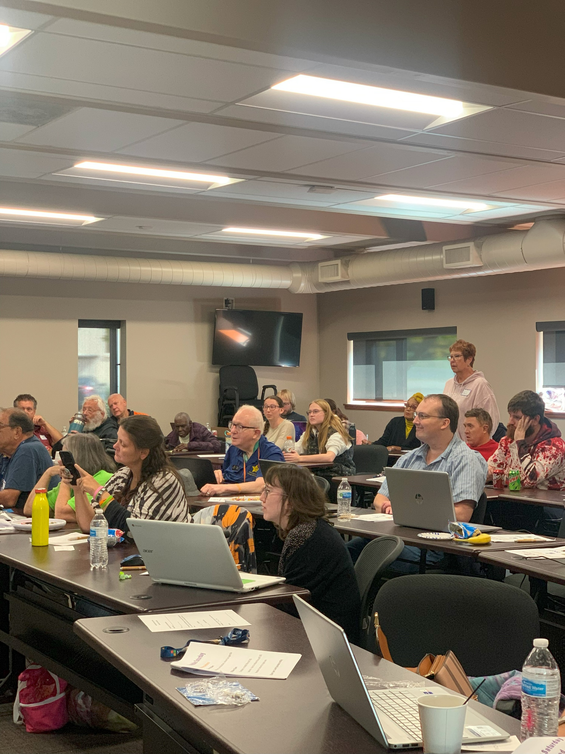

SFO Meetings
Monthly Call: every first Monday of the month
Quarterly Meetings: Zoom, in-person, or hybrid every Quarter
Meetings include both SFO members and Advisors from across the State.

Slide 10
Local: People First of Jefferson County
People First of Jefferson County is a group of self-advocates and Arc advisors that meets the first Wednesday of every month. This group is a local chapter of Speaking For Ourselves – Colorado, which holds quarterly meetings around the state. Members of both groups focus on making positive changes in our community and beyond, becoming stronger self-advocates, and supporting each other. We share fellowship within our chapter and with other chapters around the state. No matter how serious the topic, we always incorporate fun things.
People First meetings are held the first Wednesday of every month from 5:30 – 6:30 PM at The Arc's office in Lakewood.
Video: People First of Jefferson County!

Slide 11
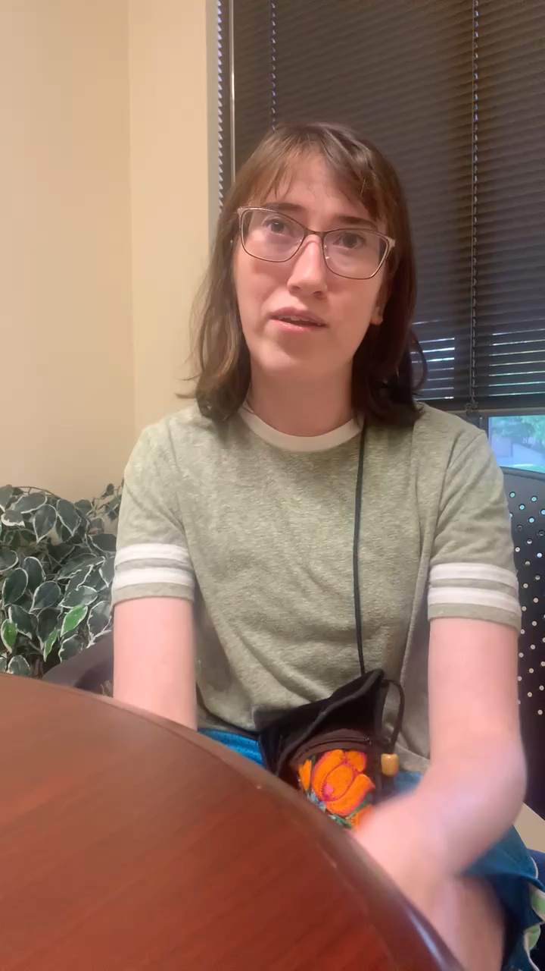
Why should someone join People First?

Slide 12
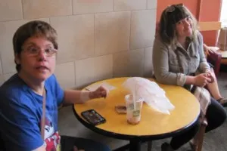
Coffee House is a monthly social gathering that takes place at Panera Bread in Belmar (650 S. Wadsworth Blvd, Lakewood) every third Thursday of the month. It’s one of those occasions where everyone is welcome and pretty much everybody knows your name. Come and make new friends, mingle with people of all abilities, and promote inclusion in our community.
Coffee House

Slide 13
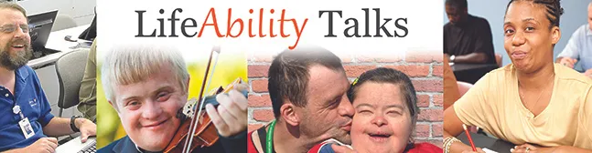

LifeAbility Talks are fun, free, interactive discussions designed to strengthen the abilities of self-advocates with intellectual and developmental disabilities. The talks are led by experienced self-advocates who cover topics that promote more independent, satisfying lives. Did we mention they're also really fun?

Slide 14
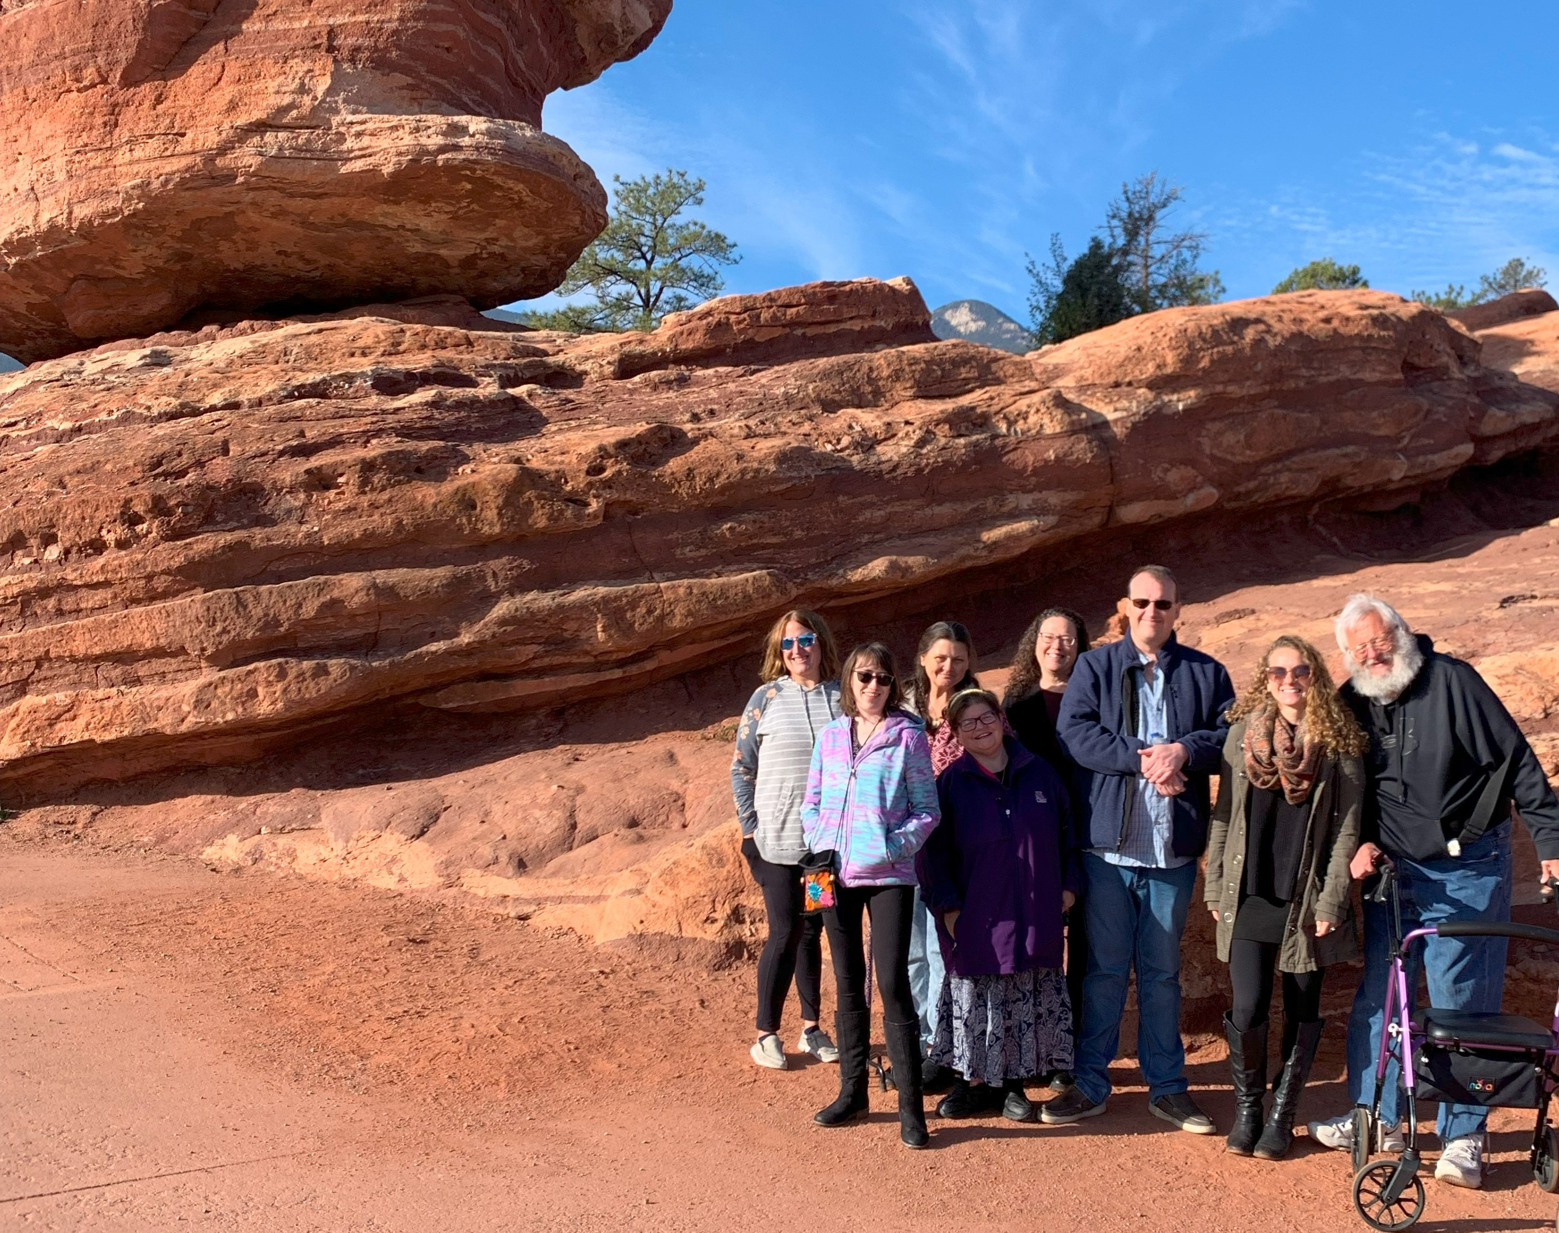
Join us!

